Slide 1
Handbook of Empirical Corporate Finance: The Financial Checkup and Valuation by Bexa Capital Advisors
Spring 2011

Slide 2
Table of Contents
1 | About the Financial Strategy Group
2 | The Financial Checkup
3 | Quantitative Credit Ratings
4 | Optimal Capital Structure
5 | Liability Management
6 | Pension & OPEBs
7 | Optimal Cash Balance
8 | Shareholder Payout Policy
9 | Stock Price Effect of Corporate Actions
10 | Foreign Exchange Exposure Management
11 | Cost of Capital
12 | International Cost of Capital
13 | Conglomerate Discounts

Slide 3
About the Financial Strategy Group
Bexa Capital Advisors Origins

Slide 4
Bexa Capital Advisors
Who
Why
A small team of bankers
Differentiate Investment Banking
When
Financial
Strategy
Group
How
From pitch to closing as integral part of client team
Provide analytical value-added services
What
To
Corporate finance, capital raising and M&A issues
Investment Bankers, product professionals, and clients
Bexa Capital Advisors is a successor Firm to the Financial Strategy Groups at Salomon Brothers and Credit Suisse. Bexa is an analytical think tank, working jointly with product specialists, banking teams and clients to design solutions for a broad array of corporate finance questions.

Slide 5
Products and Services
The Financial Checkup
Quantitative Debt Capacity
  For Acquisitions
  For Share Repurchases
Optimal Debt / Equity Mix
  For Credit Rating
  For Value Creation
  For Sentiment
Optimal Cash Balance
  For Liquidity
  For Strategic Purposes
Liability (Strategic Risk) Management
  Maturity Profile, Fix / Float Mix
  Currency Mix
Corporate Payout Policy
  Share Repurchases / Dividends
Valuation Drives
  Growth, Credit Rating, Payout
Macroeconomics and Corporate Finance
  Jobs, Inflation, Interest Rates, Sentiment and Issuance Strategies
Special Projects
Asset Allocation
Capital Allocation
Complex Valuations (e.g. Optionalities)
Conglomerate Discounts
Corporate Finance and Macroeconomics
Dividend Policy
Dynamic Capital Structure Arbitrage
Employee Stock Options
Hedging Foreign Exchange Risk
Index Reweightings
Options on Bank Credit Spreads
Pensions and Liability Management
Sovereign Liability Management
Spinoffs vs. Carve-outs
Stock Splits
TARP Warrant Auctions
Valuation in Emerging Markets
Valuing Illiquid Securities

Slide 6
Selected Bexa Publications
Title/Topic | Title/Topic
Bulletin: 50- and 100- Year Bonds | Reflections on the Global Economic Outlook
Capital Structure in the New Normal World | Revised Valuation Methodologies for Mergers and Acquisitions
Century Bonds – Send a Signal to the Market | Share Buybacks and Market Corrections
Conglomerate Discounts: Causes and Remedies – Spin-Offs, Carve-Outs, Splits | Stock Splits and Reverse Splits
Corporate Governance and Stock Price Performance | The 2007-2009 Financial Crisis in a Historical Context
Corporate Payout Policy | The Case for Delevering: Theory and Empirical Evidence
Debt and Equity Issuance Strategies under Various Macroeconomic Scenarios | The Case for Long Term Debt
Dividends and Capital Structure at IPO | The CFO Quarterly
Empirical Evidence on Equity Follow-On Offerings | The Corporate Treasurer’s Guide to Options
Employee Stock Options | The Corporate Treasurer’s Guide to Using Interest Rate Derivatives
Expensing Stock Options | The Cost of Capital in Japan and the United States: A Tale of Two Markets
Financial Strategy in Slowdowns | The Economic Outlook: Jobs, Inflation, Interest Rates, and Investment Strategies
Foreign Exchange Options: The Leading Hedge | The Effects of Monetary and Real Disturbances on the Real Exchange Rate
Foreign Exchange: Transactions in Spot, Forwards, Swaps, Futures, and Options | The Executive’s Guide to Foreign Exchange Exposure Management
Issuance Strategies Under an Inverted Yield Curve | The Executive’s Guide to International Capital Budgeting
IPO Lockup Expirations: The Empirical Evidence | The Financial Checkup: Drivers of Equity Valuation, Credit Ratings, Capital Structure,
Issuing Converts: Reasons and Stock Price Reaction | Liability Management, Shareholder Return Strategies, and Corporate Governance
Issuing Corporate Put Bonds | The Industry Cost of Equity
Issuing Corporate Callable Bonds – The Time Is Right | The International Cost of Capital – The Empirical Evidence
Issuing Put Bonds Synthetically to Reduce Financing Costs | The Sovereign Issuers Quarterly
Managing Capital Structure Risk and Dynamic Capital Structure Arbitrage | The Universal Shelf – The CFO’s Toolbox
Managing Foreign-Exchange and Commodity Risks for Private Equity Firms | Valuing Average-Price Options
Political Risk Premiums | Valuing Employee Stock Options by Monte Carlo Simulation
Purchasing Power Parity in the Long Run | Valuing Illiquid Equity Securities in Light of the Financial Crisis of 2007-2009
 | WACC User's Guide

Slide 7
The Financial Checkup

Slide 8
Summary Observations
Credit Ratings
and Debt Capacity
    Moody’s and S&P currently rate the Company as and , respectively
      According to the agencies, the ratings are supported by the Company’s strong business profile, conservative financial philosophy, and modest financial risk
    Our quantitative credit rating analysis suggests that the Company’s credit quality is slightly stronger than its current rating
      Leverage ratios such as market value leverage and debt / EBITDA, combined with size, imply a credit quality for the Company
    Quantitatively, the Company’s credit rating would decline by a full notch as a result of either a
    $ million debt-financed share buyback or a $ million debt-financed acquisition
    Based on projections, our quantitative analysis suggests that the Company’s credit rating can potentially improve by a notch by the end of 2007
Optimal Capital
Structure
    The Company’s optimal leverage - based on the cost of capital approach - corresponds to market value leverage around range, debt / EBITDA around and a rating in the area
      The Company’s current market value leverage is % and its debt / EBITDA ratio is x
    Using average spreads for the last five years as an indicator of the Company’s long-term cost of debt, weighted average cost of capital is minimized when market value leverage is in the % to % range
      This corresponds to a debt / EBITDA of between x and x and a mid to low credit rating
    A number of considerations may argue for a conservative leverage profile
      Maintaining firepower for future acquisitions, access to the A-1/P-1 commercial paper market, and peer analysis may suggest a more conservative capital structure

Slide 9
Summary Observations (Cont’d)
Optimal Cash Balance
    The Company’s current cash balance of million is at the lower end of the range suggested by peer analysis. The Company’s liquidity position is, however, supported by a revolving credit facility of million
    Medians of peer cash ratios suggest that the Company should hold a cash balance of to
    million
    We also utilize a Monte-Carlo simulation analysis that assesses the risk of a liquidity event
      Based on the distribution of historical returns on assets for the sector, our analysis suggests a cash balance of to million, although committed but undrawn credit facilities may serve, at least in part, as a replacement
Liability Management
    The Company’s weighted average maturity is years, while the median of the its peers is around years
      Comparatively, companies in this sector and companies with ratings tend to have an average maturity between to years
    The Company’s floating rate exposure of %⁽¹⁾ is lower than the median for the peer group
      A Value-at-Risk (VAR) analysis shows a negligible impact on the Company’s earnings from movements in short-term rates, supporting a higher floating rate target
      However, based on a historical analysis of the level of rates and the slope of the yield curve as well as other macroeconomic variables, issuing term debt today may be a winning strategy from a cost perspective
Payout Policy
    Investors continue to seek cash payouts from US companies, and companies are responding with share repurchase programs and dividends
    Larger buybacks and dividends are associated with stronger stock price reactions, although large dividend increases do not perform as well
      Empirically, accelerated share repurchases help large capitalization companies maintain greater stock price momentum
(1) Illustrative estimate based on public information such as company filings and press releases. Includes the effect of interest rate swaps.

Slide 10
Quantitative Credit Ratings

Slide 11
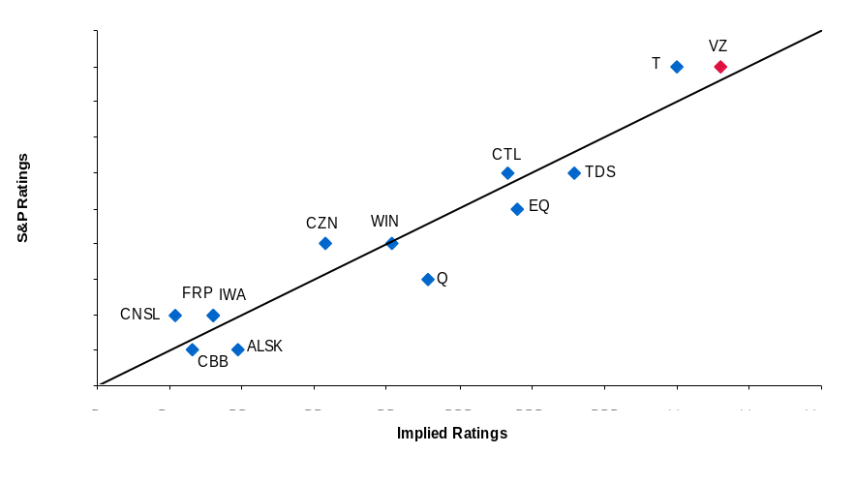
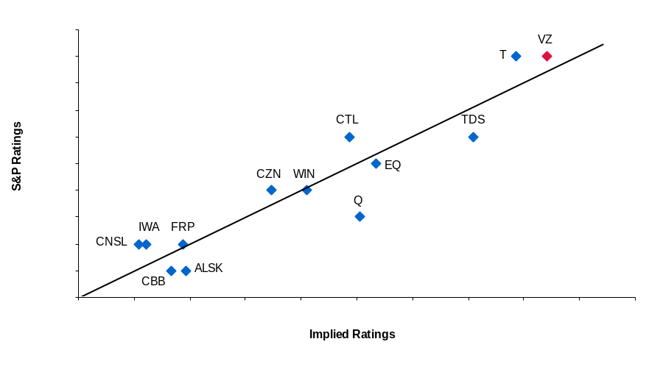
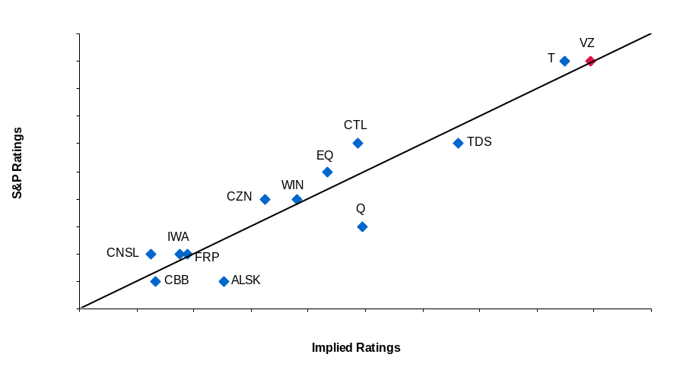
Ratings in the Telecommunications Industry
Debt / EBITDA
Net Debt / EBITDA
Credit Rating⁽¹⁾ = 9.62 – 1.67 x Total Debt / EBITDA (x)
(2.64) (0.35)
+ 0.44 x Total Sales ($ mm, Natural Log Scale)
(0.21)
Adj. R-Squared = 90%
Credit Rating⁽¹⁾ = 5.78 – 1.13 x Net Debt / EBITDA (x) (2.63) (0.34)
+ 0.68 x Total Sales ($ mm, Natural Log Scale)
(0.23)
Adj. R-Squared = 84%
Market Value Leverage
Net Market Value Leverage
14.0000
Credit Rating⁽¹⁾ = 6.19 – 10.35 x Total Debt / Market Cap. (%)
(2.41) (2.71)
+ 0.77 x Total Sales ($ mm, Natural Log Scale)
(0.19)
Adj. R-Squared = 87%
A+
Credit Rating⁽¹⁾ = 3.99 – 7.52 x Net Debt / Net Market Cap. (%) (2.34) (2.46)
+ 0.88 x Total Sales ($ mm, Natural Log Scale)
(0.21)
Adj. R-Squared = 83%
13.0000
T
VZ
A
12.0000
A-
11.0000
BBB+
CTL
BBB
S&P Ratings
10.0000
TDS
BBB-
9.0000
CZN
EQ
BB+
8.0000
WIN
Q
BB
7.0000
IWA
FRP
BB-
6.0000
CNSL
B+
5.0000
CBB
ALSK
B
4.0000
B
B+
BB-
BB
BB+
BBB-
BBB
BBB+
A-
A
A+
Implied Ratings
The Company’s pro forma debt / EBITDA and sales suggests a credit quality below its current rating of .
(1) Credit rating is expressed as a number ranging from 18 (“AAA”) to 1 (“CCC”).

Slide 12
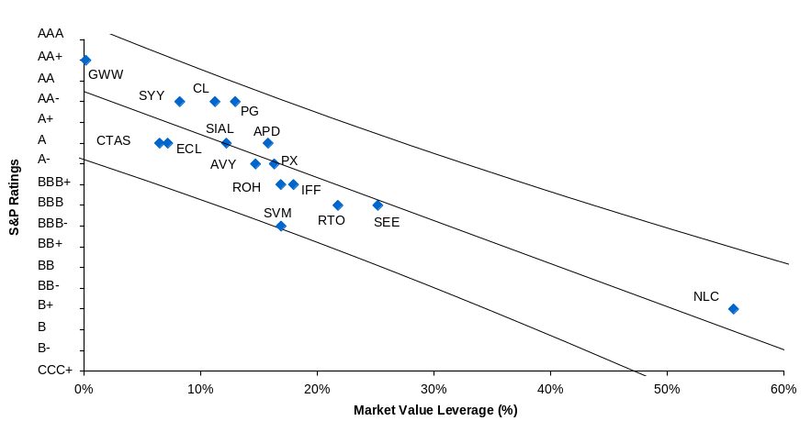
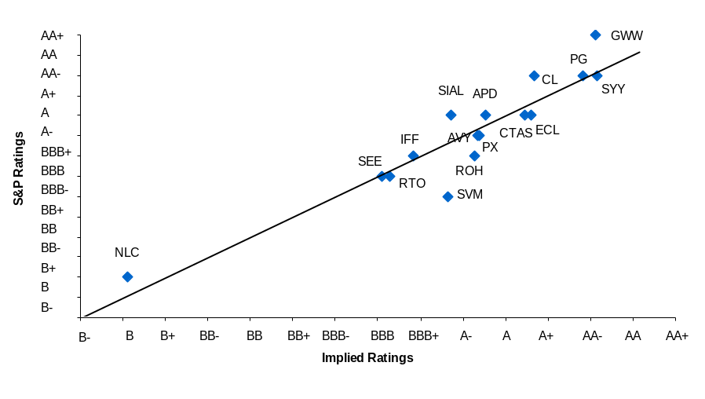
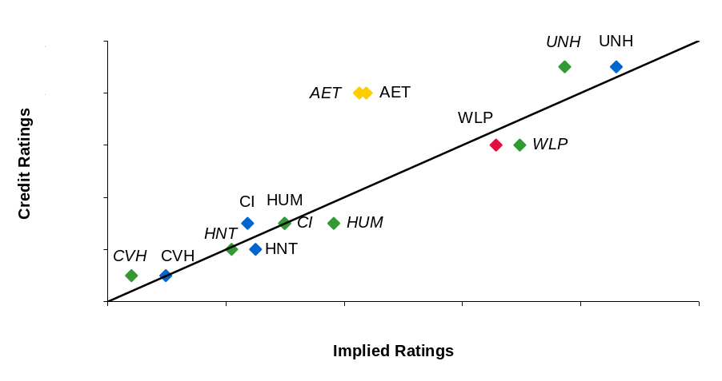
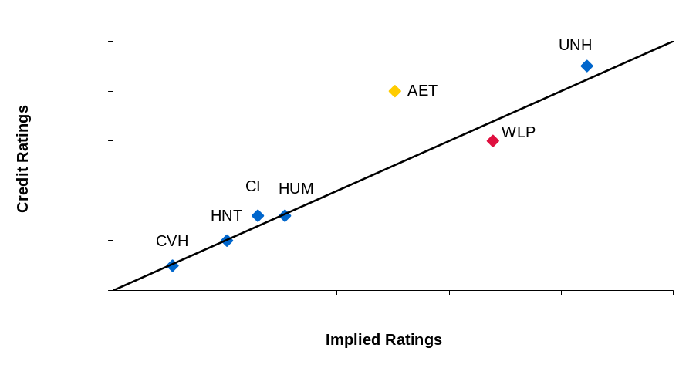
Ratings in Consumer Prods. & Healthcare
Market Value Leverage (Consumer Prods)
Market Value Leverage and Size (Consumer Prods)
Credit Rating⁽¹⁾ = 15.49 - 0.21 x Total Debt / Total Market Cap (%) (0.60) (0.03)
R-Squared = 78%
Credit Rating⁽¹⁾ = 7.39 - 0.19 x Total Debt / Total Market Cap (%) (2.98) (0.03)
+ 0.90 x Total Sales ($ mm, Natural Log Scale)
(0.33)
Adj. R-Squared = 84%
Market Value Leverage and Size (Healthcare)
Debt / EBITDA and Size (Healthcare)
Credit Rating⁽¹⁾ = -7.26 - 17.58 x Total Debt / Total Market Capitalization (%) (1.63) (6.90)
+ 1.90 x Sales ($ mm, Natural Log Scale)
(0.19)
Adj. R-Squared = 96%
Credit Rating⁽¹⁾ = -7.27 - 1.85 x Total Debt/ EBITDA (x)
(1.59) (0.70)
+ 1.90 x Sales ($ mm, Natural Log Scale)
(0.19)
Adj. R-Squared = 96%
The Company’s pro forma debt / EBITDA and sales suggests a credit quality below its current rating of .
(1) Credit rating is expressed as a number ranging from 18 (“AAA”) to 1 (“CCC”).

Slide 13
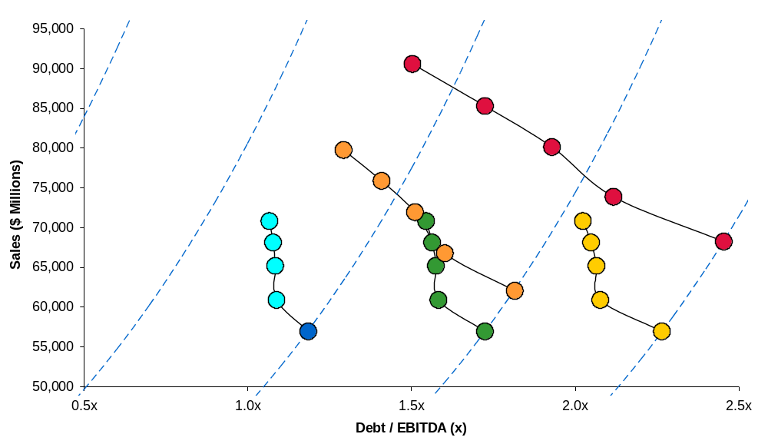
Ratings Migration
A
A-
BBB+
BBB
2011E
2010E
2011E
2009E
2010E
2008E
2009E
2010E
$10.4 Billion debt-financed Acquisition⁽¹⁾
2010E
2010E
2009E
2009E
2008E
2009E
$4.7 Billion debt-financed Acquisition⁽¹⁾
2008E
2008E
2008E
2007E
2007E
2007E
Current
$3.2 Billion Share Repurchase
$6.4 Billion Share Repurchase
(1) Analysis assumes FV / EBITDA and FV / Sales multiples of 8.9x and 0.9x, respectively. Other assumptions are that incremental sales and EBITDA grow at a 15% rate, free cash flow is 75% of EBITDA, and incremental free cash flow is used to pay down additional debt.
Source: Wall Street research and our statistical models of drivers of credit rating, based on debt / EBITDA and sales.
Note: our analysis is quantitative in nature and is based on public information. Rating agencies often base their analysis on privileged information and apply qualitative judgment.
Quantitatively, the Company can complete a $3.2 billion debt-financed share repurchase or a $4.7 billion debt-financed acquisition and still maintain its BBB+ credit rating.

Slide 14
Optimal Capital Structure

Slide 15
Leverage Considerations
Investor Survey: What Would You Most Like to See Companies Do with Cash Flow?
Increase Capital Spending
Return Cash to Shareholders
Rebuild Balance Sheets
Source: ML Global Fund Managers Survey – May 2007.
Factors Influencing Capital Structure
Empirical Drivers of the Leverage Decision
    Cost of Capital
    Shareholder Value Strategy
    Consistency of Market Access
    Debt Mitigates Principal-Agent Problems
    Debt-Equity Arbitrage
    Risk Tolerance
    Funding Requirements
    Capacity for Acquisitions
(4 = Very Important; 0 = Not Important)
Factors in Choosing Debt Level
Source: “The Theory and Practice of Corporate Finance: Evidence from the Field,” Graham and Harvey (2001). The study compiled the responses of nearly 340 CFOs.

Slide 16
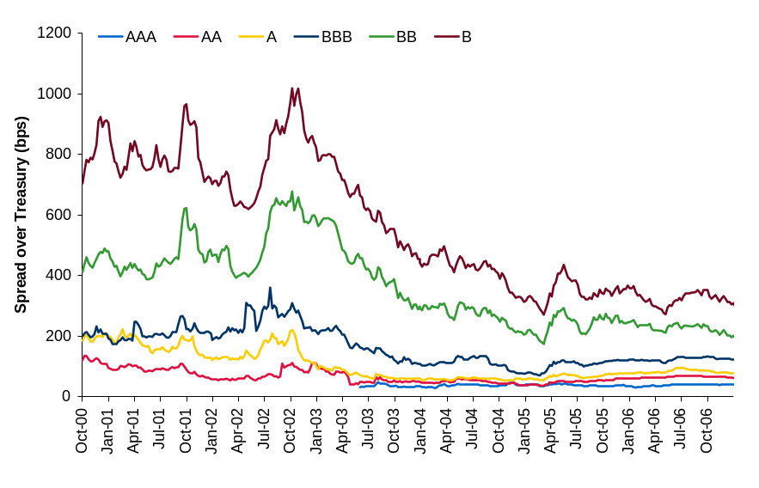
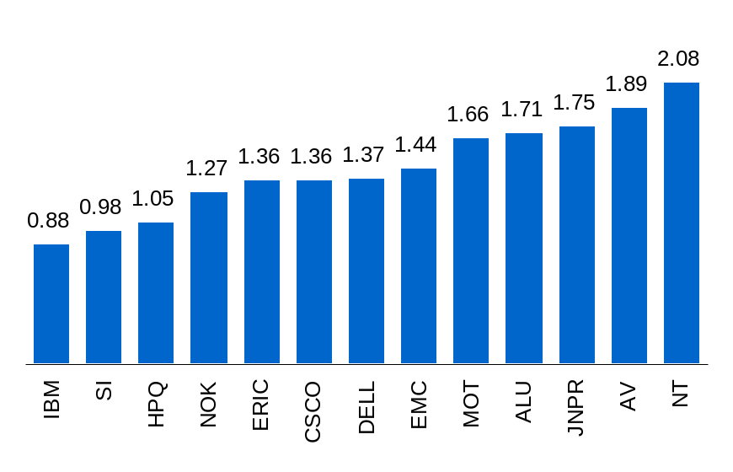
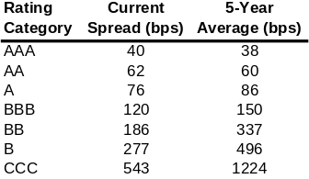
Calculating a Company’s Cost of Capital
We model optimal capital structure by calculating WACC
    For each credit rating, benchmark indices are used to predict changes in the Company’s cost of debt
    Relatively tight spread differentials between rating categories currently encourages companies to employ leverage more aggressively
    We use Barra predicted betas, which use stock market and financial data to predict the Company’s beta going forward, to estimate the Company’s cost of equity
Historical US Treasury Spreads by Rating Category
Cost of Equity: Barra Predicted Betas
Median: 1.37
Note: 7-10 year maturity benchmark spreads as per LUCI and HYII indices.
Note: Predicted local betas as per Barra as of February 2007.

Slide 17
Capital Structure: Empirical Evidence
S&P 500 - Healthcare Companies
All U.S. Companies
Median: BBB
Median: BB
Source: Bloomberg and Factset as of March 2007.
Source: The distribution for all US rated companies is per S&P research report “Global Credit Trend: Quarterly Wrap-Up and Forecast Update”,Q3 2005.
All S&P 500 Companies, 1989
All S&P 500 Companies, Today
Median: A
Median: BBB+
An ‘A’ rating is likely attractive because of higher financial flexibility and
A-1/P-1 access.
The current median for all S&P 500 companies is ‘BBB+’ versus ‘A’ over a decade ago.
Source: Bloomberg.
Source: Bloomberg and Factset as of March 2007.
The current median S&P rating for all S&P 500 companies is BBB+ while the most frequent rating is BBB. However, the current median for the Healthcare sector is BBB.

Slide 18
Building Blocks of WACC
Weighted Average
Cost of Capital
Cost of Debt
Cost of Equity
Risk-Free Rate
Credit
Spread
Country/ Political Risk Premium
Tax Shield
Risk-Free Rate
Equity Beta
Equity Market Risk Premium
Country/ Political Risk Premium
Business Risk
Financial Risk
The WACC is the weighted average of the cost of equity and the cost of debt, where the weights for the cost of debt and the cost of equity are determined by market values of equity and debt. Because a number of factors in WACC are of a statistical nature, WACC should be viewed as a range rather than a point estimate.

Slide 19
Building Blocks of the Cost of Equity
RISK-FREE RATE
EQUITY BETA⁽¹⁾
Because equity is a long-term investment, a risk-free rate representing a long-term horizon is most appropriate. Consequently, we utilize the 30-year U.S. Treasury as the risk-free rate in the CAPM.
The beta is a risk measure which represents the non-diversifiable risk associated with an equity investment measured relative to the overall equity market. It is a function of asset risk and financial risk.
We prefer to use industry betas vs. company betas - Industry betas are more stable and mitigate against outliers. Most individual company betas are not statistically distinguishable from industry median betas.
Industry beta is measured using equity betas of a group of comparable companies.
EQUITY MARKET RISK PREMIUM
POLITICAL RISK PREMIUM
The equity market risk premium is the excess return expected for the equity market relative to the long-term bond market. According to Ibbotson, this figure has averaged 7.1% for the U.S. equity market⁽²⁾.
Using “forward looking” methods will yield a risk premium in the 4.5%-6.5% range.
Most practitioners use an equity market risk premium in the 5% – 8% range.
The political risk premium represents the incremental return investors require for use of their funds in international investments and represents non-systematic risks such as expropriation. When the fixed income markets are well developed for a specific country, we examine dollar-denominated Yankee, Euro, and Brady bonds in order to measure an accurate political risk premium. In cases where there are no liquid dollar-denominated securities trading, we rely on a proprietary political risk premium model as well on qualitative judgments.
When calculating the asset beta for high-levered, non-investment grade companies, it is important to utilize a “debt beta” in the calculation.
Arithmetic average from 1926 to 2005, S&P 500 returns vs. long term government bond income return as per Ibbotson.
To determine the cost of equity, we utilize a modified Capital Asset Pricing Model (“CAPM”).

Slide 20
Effect of Leverage
    According to Modigliani and Miller, in a world without taxes and financial distress costs, cost of capital is independent of the firm’s capital structure.
    In the real world, there is a number of factors that affect the leverage choice:
      Tax Shield: What is the value of the lower tax burden associated with leverage?
      Non-tax Benefits of Debt: Signaling, access to funding, etc.
      Distress Costs: What is the risk of costly disruption to the business from leverage?
      Strategic Options: Should the company maintain firepower for future acquisitions?
      Short-term Borrower: Is the loss of favorable CP access economically important?
      Leverage Discount: Do investors expect higher returns from companies with higher leverage?
      Peer Analysis: Does leverage impact the company’s competitive position?
Optimal Point
Leverage Discount
CP Access
Strategic
Options
Debt Tax
Shield
Adjusted Cost of Capital (%)
Distress Costs
Baseline
(M-M)

Slide 21
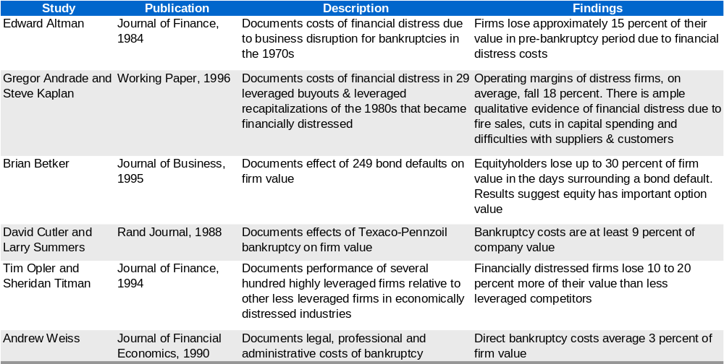
Summary of Studies of Financial Distress
    Past research suggests that direct financial distress costs due to legal, professional and administrative expenses of insolvency are approximately 3% of firm value, while indirect financial distress costs due to problems with the capital markets, customers, suppliers and competitors, range up to 25% of firm value
Academic studies serve as a benchmark for discounts in distressed situation.

Slide 22
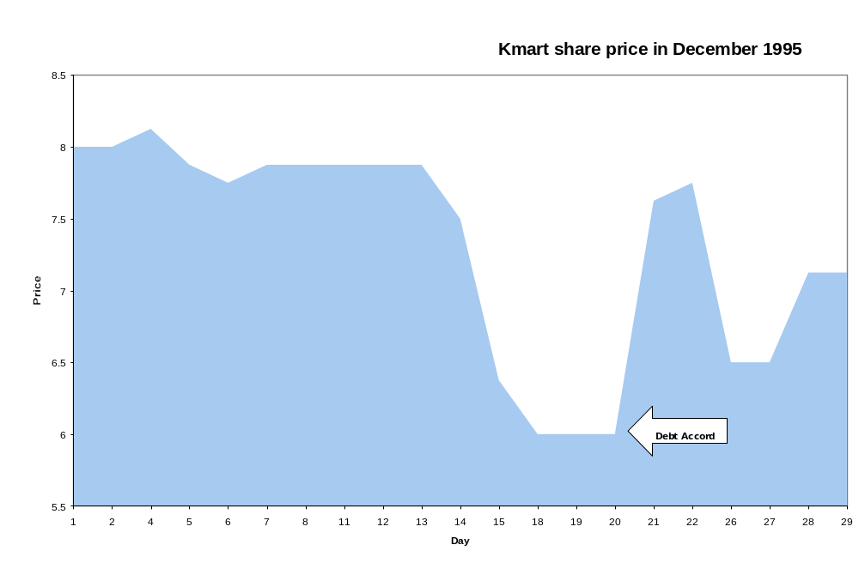
Case Study: Market Reaction to the Kmart December 1995 Debt Accord
    In December 1995, Kmart was embroiled in negotiations over certain real estate related debt that could have forced it into bankruptcy. The market believed that the accord would be difficult to reach, explaining much of the decline in share price
    When an accord was reached on December 21, 1995, Kmart’s price shot up by 27%. This is an estimate of the cost of financial distress

Slide 23
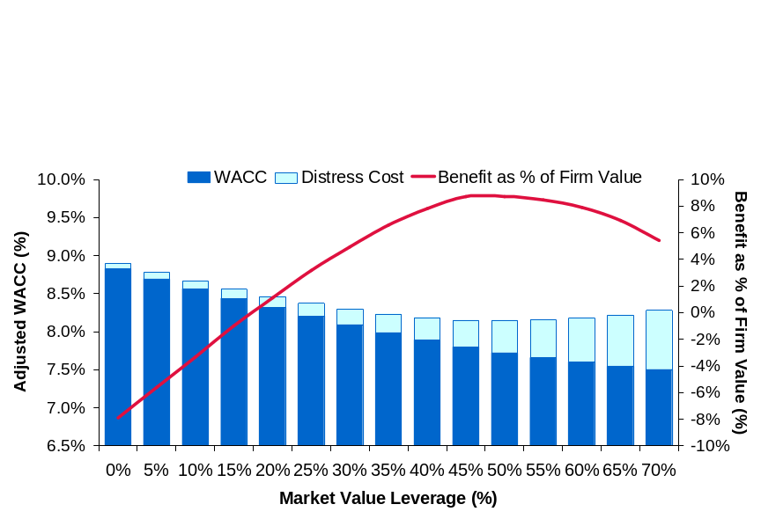
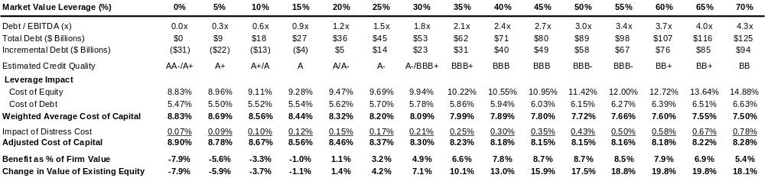
Target Capital Structure: Minimize WACC
Cost of Capital Analysis: Graphic Illustration
    The Company’s cost of capital is minimized when its credit rating is a mid to low BBB
      This corresponds to a market value leverage of around 45% to 50% and a debt / EBITDA ratio of approximately 2.7x to 3.0x
      The Company’s current market value leverage of 17% and debt / EBITDA of 1.0x are below the theoretical optimal
    Other considerations such as maintaining firepower for further strategic initiatives may suggest a more conservative capital structure
Current
Optimal
Cost of Capital Analysis: Numeric Illustration
Note: The analysis assumes that incremental debt is used to repurchase equity. Cost of equity is based on CAPM assuming a Barra predicted beta of 0.819, equity market risk premium of 5.5%, 10-year US Treasury rate of 4.78% and 30-year US Treasury rate of 4.86%. Tax rate is assumed to be 34.5%. Cost of debt as per our estimates. Analysis assumes perpetuity growth rate of 4%.
Our quantitative analysis suggests that the Company can slightly reduce its cost of capital by employing additional leverage.

Slide 24
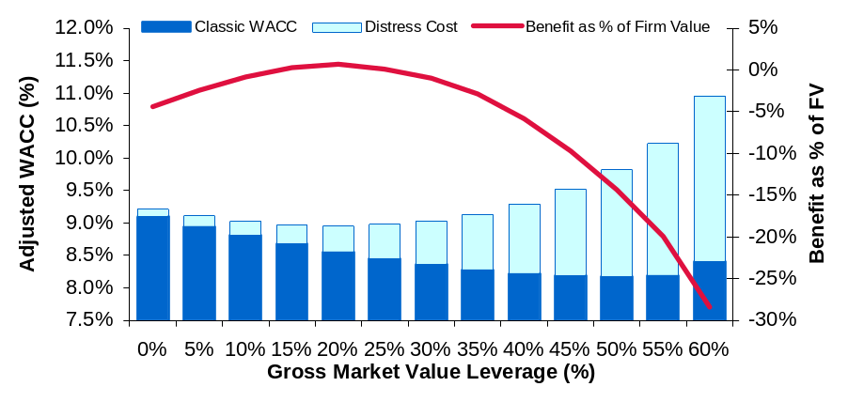
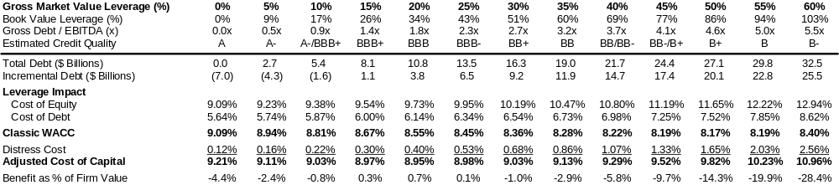
Target Capital Structure: Minimize WACC
Cost of Capital Analysis: Graphic Illustration
    The Company’s weighted average cost of capital is minimized when its market value leverage is in the 15% to 20% range (25% to 35% book value leverage)
      This corresponds to a mid to high BBB rating
      The Company’s current market value leverage is % ( % book value leverage)
    Strategic considerations might suggest a more conservative capital structure
Optimal w/o Distress
Current
Theoretical Optimal
Cost of Capital Analysis: Numeric Illustration
Note: The analysis assumes that incremental debt is used to repurchase equity and vice versa. Credit quality estimates are based on debt / EBITDA and sales. Current credit rating is assumed to be BBB+ as per S&P. Cost of equity is based on CAPM assuming a current peer median Barra predicted beta of 0.82, an equity market risk premium of 5.5%, and 30-year risk-free rate of 4.99%. Cost of debt is based on LUCI (high grade) and High Yield II indices and assumes a 10-year term. Tax rate is assumed to be 37.6%. The analysis assumes the Company loses 50% of enterprise value if in financial distress.
The Company’s cost of capital is minimized when its market value leverage is around 15% to 20%, corresponding to a mid to high BBB credit rating.

Slide 25
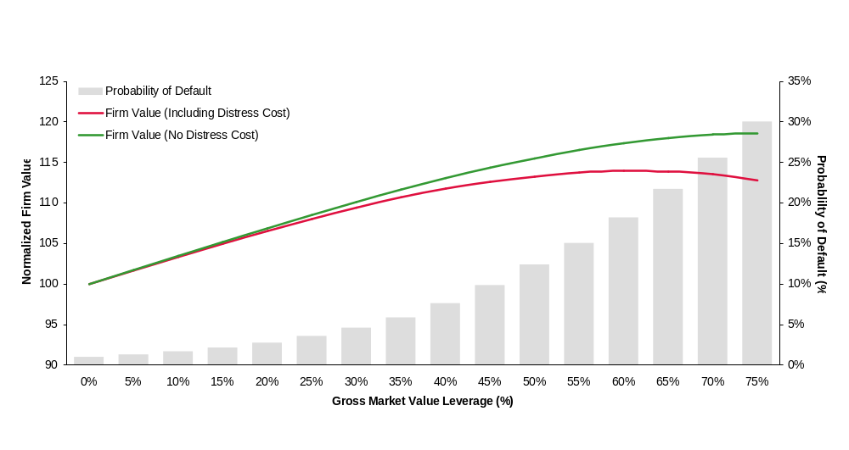
Target Capital Structure: Adjusted Present Value Approach
    The Adjusted Present Value (“APV”) theory suggests that the value of a firm is equal to the value of a 100% equity financed firm plus the expected tax shield as the Company levers up minus the expected distress costs
      Our APV model uses a probability weighted approach to calculate the expected tax shield and the expected cost of distress at each debt level
Adjusted Present Value Analysis: Graphic Illustration
Theoretical Optimal
Pro Forma
Current
Rating:
Note: The analysis assumes that incremental debt is used to repurchase equity and vice versa. Tax rate is assumed to be 35%. Default probabilities are based on 15-year cumulative empirical default rates as per S&P. Distress costs are assumed to be 20% of firm value.
Adjusted present value analysis suggests that firm value for the Company is maximized when market value leverage is approximately 55% to 60%.

Slide 26
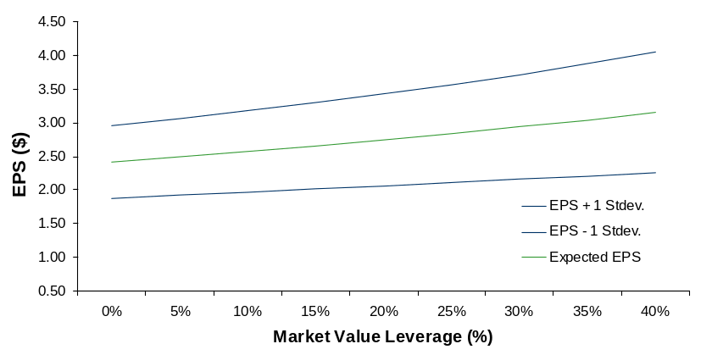
Effect of Leverage on EPS and EPS Volatility
Impact of capital structure on EPS
    We looked at historical operating income volatility to estimate the Company’s business risk for different levels of leverage
    The model pro-formas various amounts of leverage and estimates both the expected EPS and EPS volatility
    The results of this analysis show that increasing leverage results in increased EPS, however it also results in increased volatility of EPS
    Different points on this EPS-EPS Volatility graph represent efficient risk-return trade-offs and form an ‘efficient frontier’ of capital structure
EPS and EPS Volatility Analysis
Pro Forma for Dispositions
Pro Forma for Dispositions & ABC Stake
3.50
30%
35%
40%
3.00
10%
15%
20%
25%
2.50
0%
5%
Expected EPS ($)
Current
2.00
1.50
1.00
0.50
0.50
0.55
0.60
0.65
0.70
0.75
0.80
0.85
0.90
EPS Volatility ($)
Predicted EPS Changes with Increases in Leverage
Current
Pro Forma for Dispositions & ABC Stake
Pro Forma for Dispositions
The Company’s reduced leverage will marginally decrease its EPS volatility.
Note: We estimate the trade-off between EPS and EPS volatility for each level of leverage. The cost of debt is adjusted to reflect the Company’s financial profile. EPS volatility is based on historical EBIT volatility, where unexpected changes in EBIT determine the distribution of EPS.

Slide 27
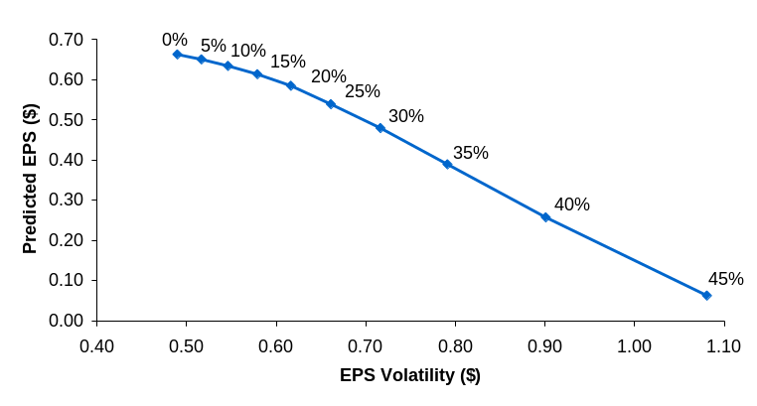
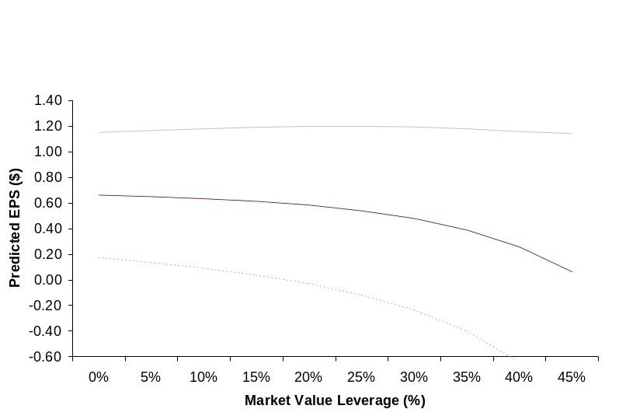
Effect of Leverage on EPS and EPS Volatility
Impact of capital structure on EPS
    We looked at historical operating income volatility to estimate the Company’s business risk for different levels of leverage
    The model pro-formas various amounts of leverage and estimates both the expected EPS and EPS volatility
    As a growth company in the biotech industry, the client has a high P/E ratio which makes repurchasing equity and issuing debt costly
    Our analysis shows that for the company, any increase in leverage over 0% reduces EPS and increases its volatility
EPS and EPS Volatility Analysis
Predicted EPS Changes with Increases in Leverage
Because the company has a high P/E multiple, an increase in debt would be EPS dilutive.
Note: We estimate the trade-off between EPS and EPS volatility for each level of leverage. The cost of debt is adjusted to reflect the company’s financial profile. EPS volatility is based on historical EBIT volatility, where unexpected changes in EBIT determine the distribution of EPS.

Slide 28
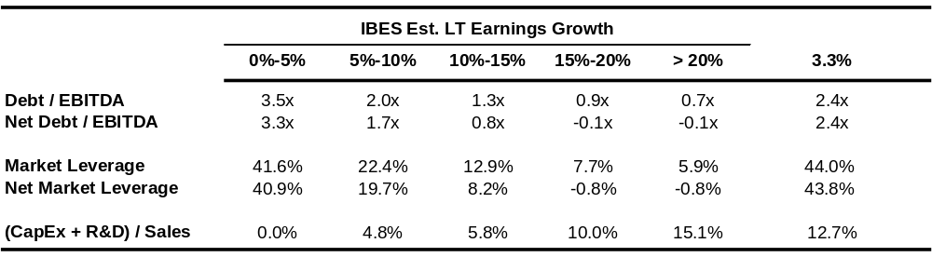

Maturing Companies Employ More Aggressive Capital Structures
    Our study of financial ratios and long-term growth rates for the S&P 500 index finds that higher growth sectors tend to have more conservative balance sheets, as reflected both in terms of cash flow (EBITDA metrics) and capital structure (book and market leverage metrics)
    Mature companies realize that their capital structures leverage their stable cash flows for greater growth
    However, a more conservative capital structure may allow the Company to pursue a more aggressive growth strategy
S&P 500 Index By Long-Term Growth
Company
Source: Bloomberg, Factset as of March 2007.
The company’s debt / EBITDA is more conservative than that of mature companies.

Slide 29
Liability Management

Slide 30
Debt Portfolio: Comparable Companies
Floating Rate Debt Exposure Among Peers (%)
Median: 14%
Weighted Average Maturity of Debt Among Peers (Years)
Median: 3.2 Years
Peer analysis suggests a median floating rate exposure of around 14% and a weighted average maturity of around 3.2 years.
Source: Company filings, Bloomberg and our assumptions.
Note: Analysis incorporates interest-rate swap information where available. Current maturities of long-term debt are assumed to be refinanced with similar instruments.

Slide 31
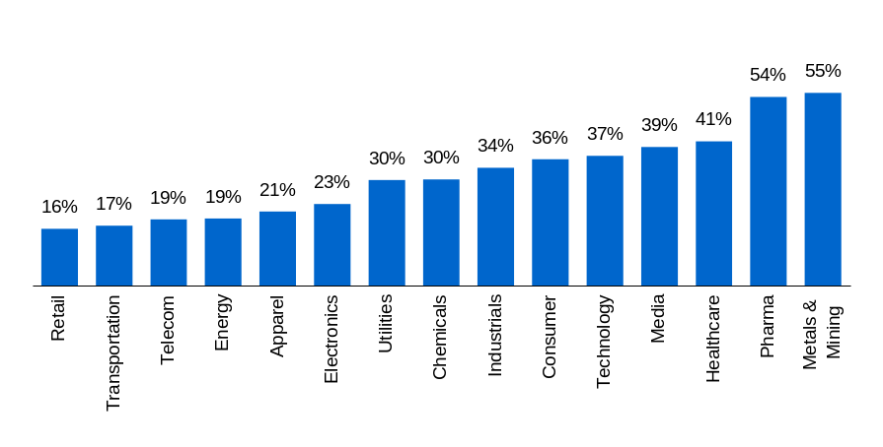
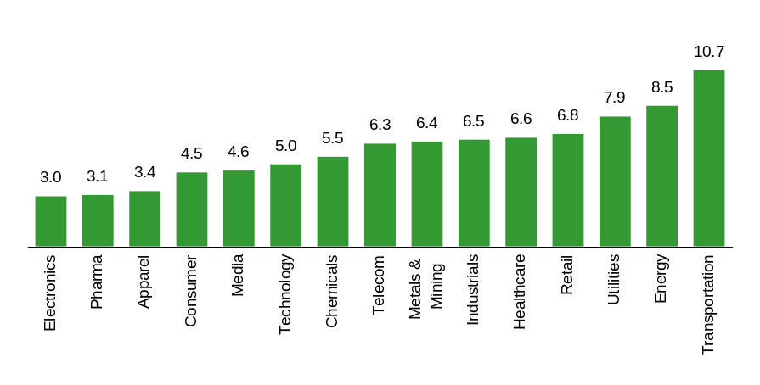
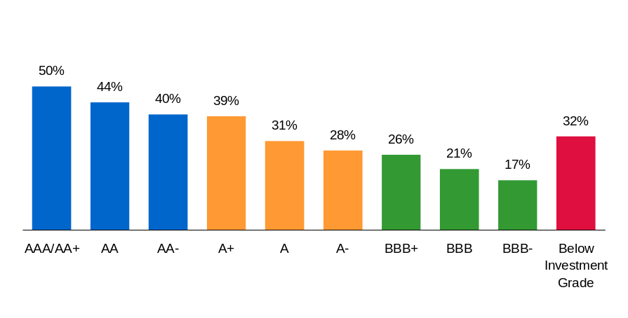
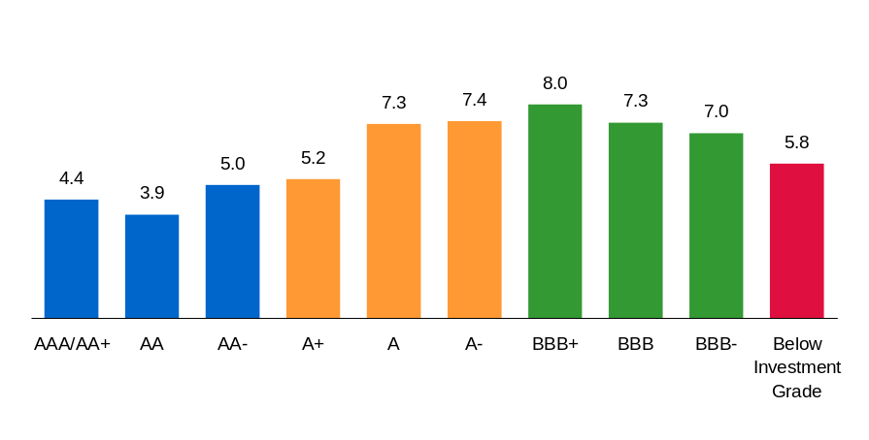
Debt Portfolio: Broad Universe
Floating Debt/ Total Debt (%)
Weighted Average Maturity (Years)
Floating Rate Exposure By Industry
Weighted Average Maturity By Industry
Floating Rate Exposure By Rating
Weighted Average Maturity By Rating
A comparative analysis by industry and by rating suggests a floating rate exposure of around 20% to 30% of total debt and a weighted average maturity of 5 to 7 years.

Slide 32
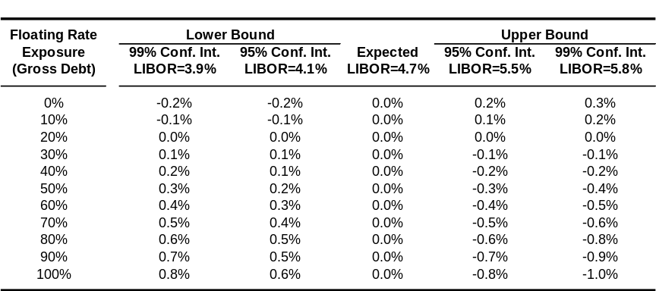
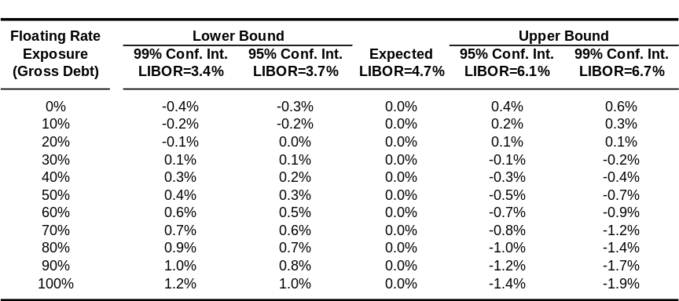
Floating Rate Exposure: Projected EPS Impact
    Floating rate financing often provides lower overall cost of borrowing in an upward-sloping yield curve environment
    However, fixed rate financing ensures borrowing cost stability
EPS Volatility for NTM: Volatility = 15%
Assumptions
EPS Volatility for NTM: Volatility = 25%
NTM EPS Estimate: $1.447
Gross Debt: $709 Million
Total Cash: $165 Million
Expected 3 months LIBOR: 4.7%
Floating Rate Exposure 19%
Source: Bloomberg, Company data, IBES.
Note: Assumes Next Twelve Months (“NTM”) expected 3 months LIBOR to be 4.7% based on average forward rates). NTM EPS as per IBES consensus.
Note: Floating rate exposure is calculated as a percentage of total debt.
Value-at-Risk analysis shows that the Company is not exposed to significant EPS volatility.

Slide 33
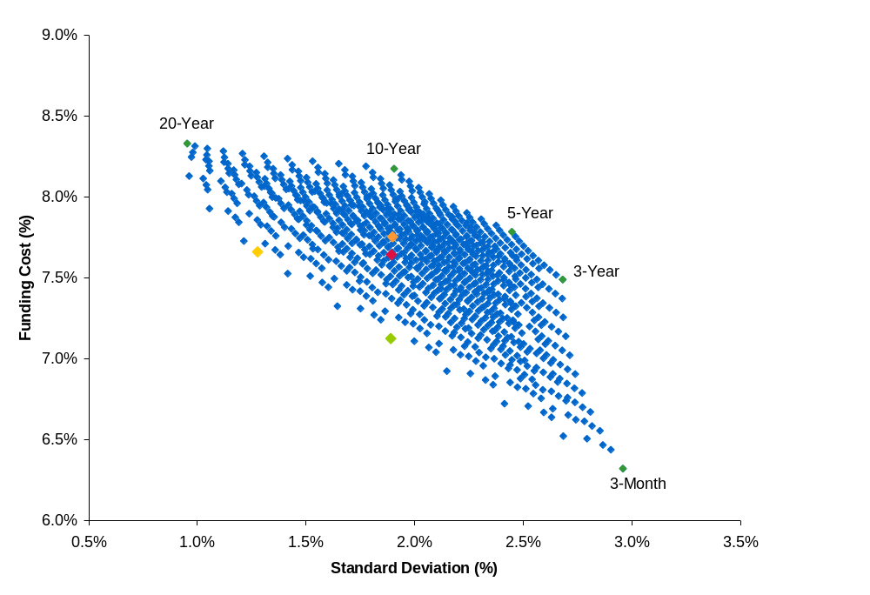
Illustrative Efficient Frontier for the Company’s Debt Portfolio
    Using historical data for US Treasuries since 1960, we calculate the trade-off between funding cost and volatility for various debt portfolios
      Funding costs and volatilities are averaged across the respective funding horizons
      The efficient frontier incorporates combinations of 3-month, 3-year, 5-year, 10-year and 20-year US Treasuries
        20-year rate is used as a proxy for 30-year rate given lack of data
PF for Acquisition⁽²⁾
(12/20/25/20/22)
Efficient Portfolio –
Lowest Volatility
at Current Cost
(33/-/-/-/67)
The Company’s Current Portfolio⁽¹⁾
(19/19/26/10/26)⁽³⁾
Efficient Portfolio –
Lowest Cost at Current Volatility
(60/-/-/-/40)
Efficient Frontier
Based on historical data, employing a barbell strategy of retaining floating and longer dated maturities results in a decrease in volatility. Currently low cost differential between long- and short-term debt suggests only a modest impact on the cost of funds.
Source: Federal Reserve and our calculations based on monthly US interest rate data since January 1960.
Note: Analysis uses Treasuries as a proxy for the funding costs of an ‘A’-rated company. The illustration uses 10% weight increments.
(1) Debt portfolio includes the effect of swaps but excludes leases, pensions and other post-retirement obligations, resulting in a normalized funding mix of 19% 3-month, 19% 3-year, 26% 5-year, 10% 10-year and 26% 20-year maturities.
(2) Scenario assumes $ billion financing for acquisition.
(3) Numbers in parentheses show the debt portfolio mix in terms of percentage of 3-month, 3-year, 5-year, 10-year and 20-year maturities: (3-month/3-year/5-year/10-year/20-year).

Slide 34
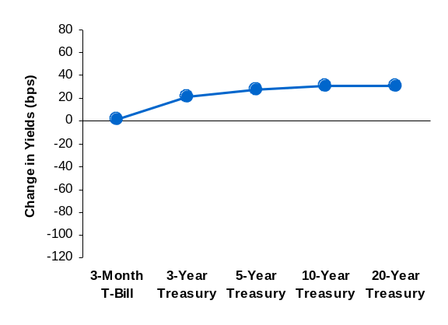
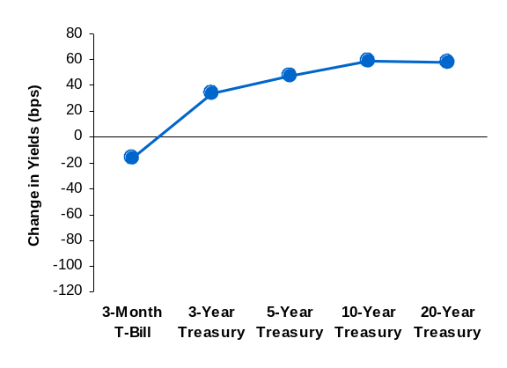
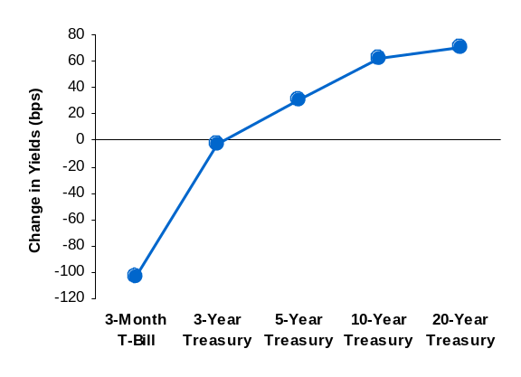
Flat Yield Curves: Treasuries
    We studied the empirical evolution of flat yield curves for U.S. treasury rates
      Flat yield curve is defined as the 10-year rate being not more than 50 basis points away from the 3-month rate
    The Treasury yield curve tends to steepen as much as 160 basis points, on average, three years after observing a flat yield curve
Evolution of Flat Treasury Curves in the U.S. (1960 – Present)
6 Months After
1 Year After
3 Years After
Source: Federal Reserve, Bloomberg. Monthly data from 1960 to present includes 108 observations when the difference between 3-month and 10-year rates was less than 50 basis points.
Empirically, flat yield curves tend to steepen over time by the short rate falling and the longer end of the curve rising. Based on observations since 1960, the 3-month Treasury rate, on average, falls around 100 basis points while the 10-year rate rises approximately 60 basis points three years after a flat yield curve is observed.

Slide 35
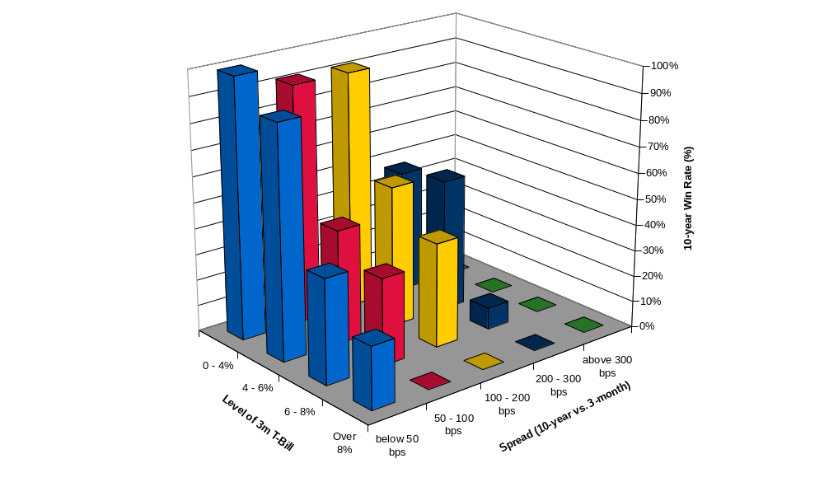
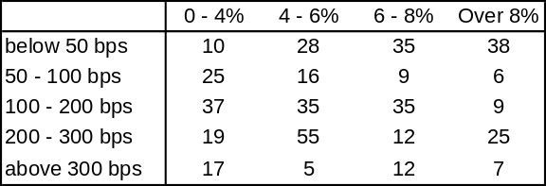
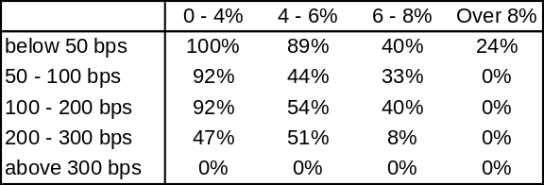
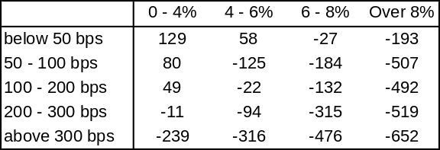
10-year vs. 3-month: US $
Win Rate of 10-year vs. 3-month, January 1960 - March 1996
Number of Occurrences (On a Monthly Basis):
3-month Rate
Spread
Percentage of 10-year Fixed Win:
3-month Rate
Spread
Average 10-year Advantage (bps) :
3-month Rate
Spread
Source: Monthly data from Federal Reserve Board.
Note: “10-year Fixed Win Rate” is defined as the percentage of times when issuing a 10-year bond would have had lower interest cost than rolling over the 3-month Treasury.
Today, the 3-month Treasury yields around 4.4% while the yield curve is flat. Between 1960 and 1996 this occurred 28 times and the 10-year had a cost advantage in around 90% of the cases and an average advantage of 58 bps.

Slide 36
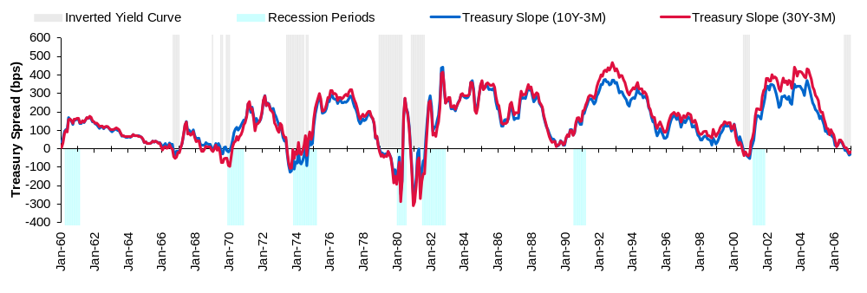
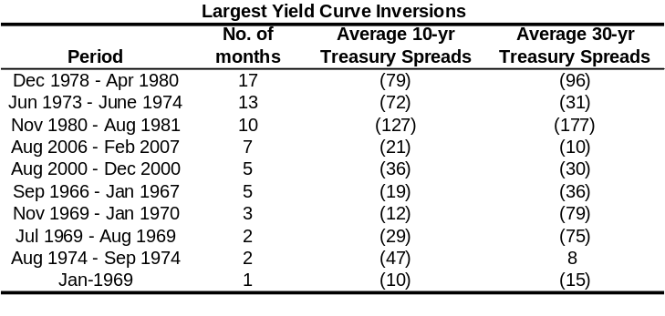
Historical Treasury Spreads
Historical Treasury Spreads
Historical Yield Curve Inversions
    Since 1960, there were three periods when the yield curve was consistently inverted for a period of six months or more and seven other instances when it reversed itself within six months
      On average, the yield curve has remained inverted for approximately five months before reverting to its more typical structure
    Currently, the yield curve has been inverted for seven months
Source: Federal Reserve as of February 2007.
Note: Analysis incorporates 20-year Treasury data when 30-year Treasury data not available.

Slide 37
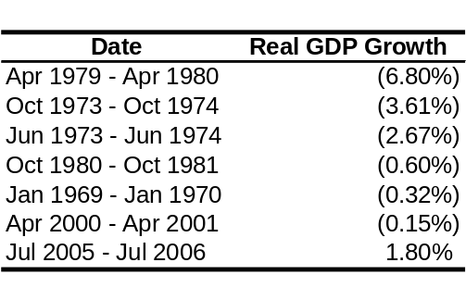
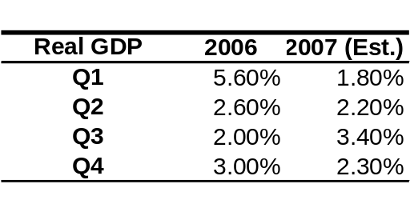
Reasons Behind Inverted Yield Curves
    An inverted yield curve has historically been linked to economic weakness and negative real GDP growth
      However in the current instance, both real GDP growth in the past year and GDP forecasts remain positive
      Recent studies using U.S. data have concluded that the predictive power of the term spread for economic activity has diminished since 1985⁽¹⁾
    The current yield curve may be driven by strong demand for long-term U.S. government bonds, and not economic weakness
      An issuer may take advantage of this strong demand by issuing long-term debt at lower yields than before
Real GDP Growth
Source: Federal Reserve Bank of St. Louis.
The dates mark periods of inverted yield curves surrounding the end of the inversion for which quarterly GDP forecasts are available.
Real GDP Growth Forecasts
Source: Economiics Forecasts, January 2007.
In recent years inverted yield curves have been attributed to higher demand for long-term instruments, enabling issuers to issue long-term debt at low rates.
(1) Andrew Ang, M Piazzesi and M Wei, “What Does the Yield Curve Tell Us About GDP Growth?,” Journal of Econometrics, 2006.

Slide 38

Causes of Low Long-Term Yields
This decline in long-term rates has occurred against the backdrop of generally firm U.S. economic growth, a continued boost to inflation from higher energy prices, and fiscal pressures associated with the fast approaching retirement of the baby-boom generation.
(T)he decline in long-term interest rates in the past year is even more pronounced in major foreign financial markets than in the United States. Two distinct but overlapping developments appear to be at work: a longer-term trend decline in bond yields and an acceleration of that trend of late. - Alan Greenspan, Federal Reserve Board's semiannual Monetary Policy Report to the Congress, June 2005
The message from the December retail sales report resonates loud and clear: the housing slowdown and cratering in mortgage equity withdrawal (MEW) did not cause consumer spending to roll over in 2006, contrary to the fears of many market commentators. Strength in the labor market is the lead explanatory variable in the aggregate economy’s ability to withstand the housing shock.
- CS U.S. Economics Digest, January 2007
    Research by the Federal Reserve indicates that investors may have become more willing to invest in long-term bonds in recent years⁽¹⁾
      This is attributed to lower inflation expectations and a reduction in long-term risks due to the stable business cycle of the past few decades
    Alternatively, financial market innovations such as derivatives may have provided investors the means to reduce long-term investment risks and made them more willing to invest long-term
      As a result, increased demand for long-term securities has caused yields on these securities to fall
(1) Testimony of Alan Greenspan, Federal Reserve Board's Semiannual Monetary Policy Report to the Congress, July 20, 2005.
The recent stability in economic conditions and financial markets has led to lower risks associated with long-term investing. This has resulted in increased demand for long-term securities and lower yields.

Slide 39
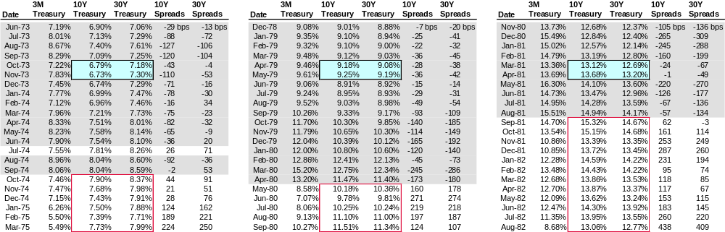
Long-Term Yields During Inverted Yield Curves
    Historically, issuing long-term debt five or six months into an extended inverted yield curve has resulted in extremely low yields
    Issuers can raise long-term debt at lower rates during the inverted yield curve compared to if they wait until the yield curve is normalized
Long-Term Yields During Three Largest Yield Curve Inversions
Long-term interest rates are often at their lowest a few months into a prolonged inverted yield curve, and subsequently rise when the yield curve is normalized.
Source: Federal Reserve as of February 2007.
Note: The grey areas represent periods when the yield curve has been inverted. The light blue areas represent long-term rates five to six months into an inverted yield curve. Analysis incorporates 20-year Treasury data when 30-year Treasury data not available.

Slide 40
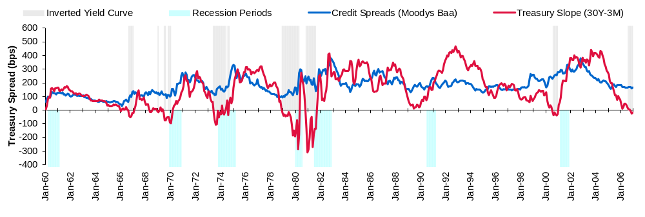
Historical Credit Spreads
Historical Credit Spreads
    Credit spreads are historically low during periods of inverted yield curve, and tend to rise in the months after the yield curve normalizes
      Currently, credit spreads are at their lowest levels in the last six years
      Credit spreads tend to rise by around 70 bps after an inversion
Source: Federal Reserve as of February 2007.
Note: The shaded areas represent periods when the 10-year Treasury yield is lower than the 3-month Treasury yield. Analysis incorporates 20-year Treasury data when 30-year Treasury data not available.

Slide 41
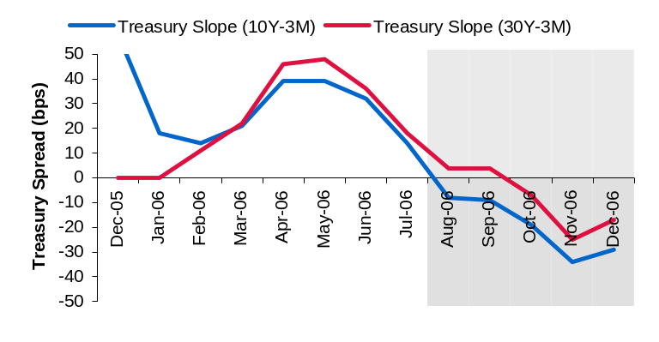
Economic Indicators
Don’t Worry About the Inverted Yield Curve
Past inversions of the yield curve occurred when monetary policy was very tight and short-term rates were high. There have been six recessions since 1961, and prior to each of them the yield curve inverted when the federal funds rate rose at least one full percentage point above nominal GDP growth, and 4.5 percentage points above the inflation rate.
Today, the federal funds rate is well below these trigger points. By either measure - nominal GDP growth or inflation - short-term interest rates are not too high. The driving force behind the inverted yield curve is low long-term rates, which are not something to worry about.
- Brian Wesbury, Chief Economist, First Trust Portfolios, January 2007
CFO Survey Shows Sustained Optimism
Overall CFOs maintain a largely positive view about the economy and their companies’ prospects. The CFO economic optimism index for the U.S. economy increased modestly to 69.2 in the fourth quarter from 67.6 in the third quarter. In the survey, CFOs gave high marks to Federal Reserve Chairman Ben Bernanke as he approached his first anniversary in office. Half ranked his overall performance as very good to excellent.
- Baruch College and FEI CFO Survey, December 2006
The Economic Outlook
Over the next year or so, the economy appears likely to expand at a moderate rate, close to or modestly below the economy's long-run sustainable pace. Core inflation is expected to slow gradually from its recent level, reflecting the reduced impetus from high prices of energy and other commodities, contained inflation expectations, and perhaps further reductions in the rate of increase of shelter costs and some easing in the pressures on capital and labor resources.
- Ben Bernanke, Chairman, Federal Reserve Board, November 2006
    Currently, the consumer confidence index⁽¹⁾ is at a 3-year high and economic indicators are strong
      Long-term rates are currently low and may be expected to rise once the yield curve reverts to normal
    For issuers, the current situation may be an ideal one in which to issue long-term debt
Current Spreads
Stable economic indicators seem to indicate that the current inverted yield curve is driven by low long-term yields. As such, it is an ideal time for issuers to issue long-term debt.
(1) University of Michigan Survey of Consumer Sentiment, January 2007.
Source: Spreads data are from the Federal Reserve.
Note: Light gray shaded areas indicate an inverted yield curve. Analysis incorporates 20-year Treasury data when 30-year Treasury data not available.

Slide 42
Pension and OPEBs

Slide 43
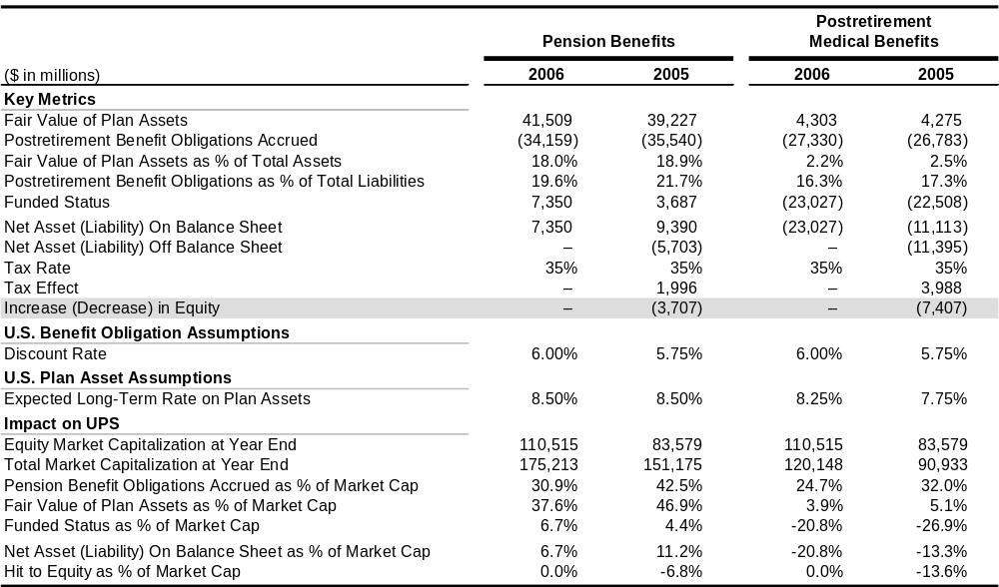
Historical Details Regarding The Company’s Pension Plan
Publicly available information provides a GAAP/Economic view of the Company’s pension plan
The Company Pension Plan Details
Source: As per 10-K for year ending December 31, 2006.

Slide 44
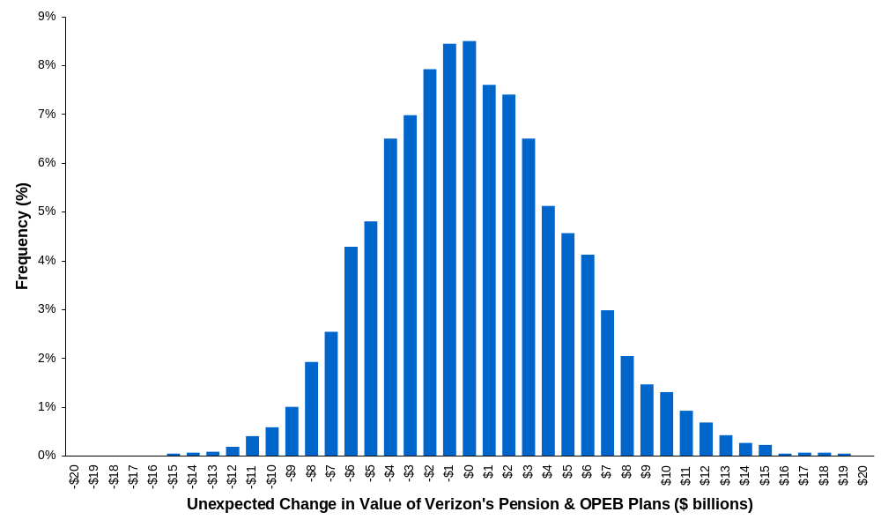
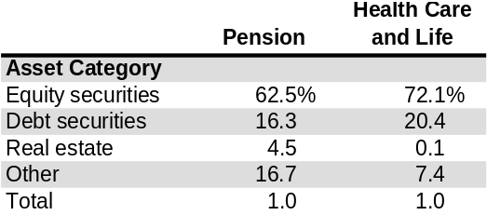
There May be Considerable Volatility in the Value of The Company’s Pension Plan
Frequency Distribution of Unexpected Change in Fair Market Value of Postretirement Plans ($ billions)
95th Percentile:
-$7.2 billion
    We use Monte-Carlo simulation to estimate the year-over-year change in net value of the Company’s pension liabilities and pension assets
We estimate that the value of the Company’s pension and OPEB plans could decline by as much as $7.2 billion within one year.
Note: The model simulates interest rates an asset returns using historical estimates for volatility and correlation based on monthly data since 1960 for US Treasury yields, BBB corporate yields and the S&P 500 index. Analysis assumes that the Company’s pension and OPEB plans have a duration of 8 years. Analysis assumes that the assets of the pension and other postretirement benefit plans are invested as per the ratios indicated in company filings.

Slide 45
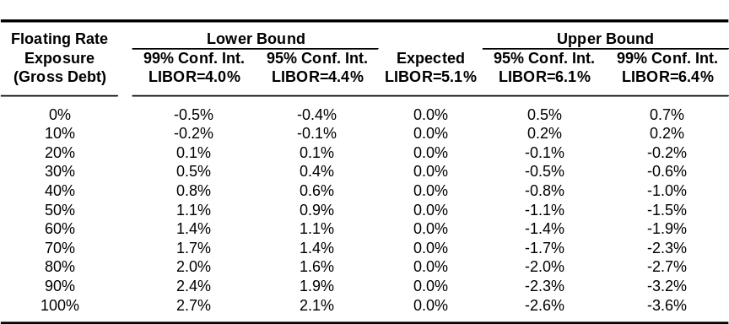
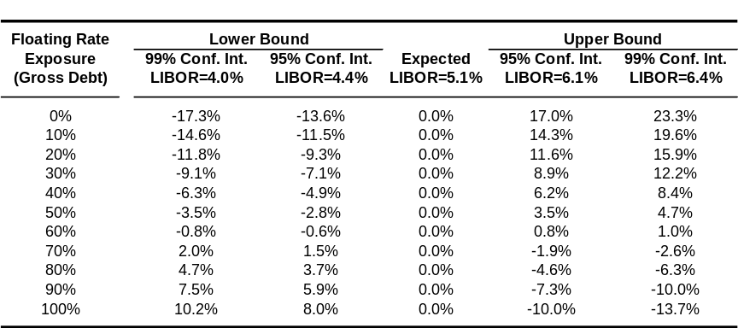
The Company Can Add Floating Rate Exposure at the Corporate Level to Offset Pension Duration Risk
    Swaps from fixed to floating rate debt affect the Company’s EPS and economic exposure
      As the Company increases its floating rate exposure, it will incur more EPS volatility
      However, floating rate debt will help to reduce the Company’s large economic exposure to interest rates from pension plan
        If FASB requires companies to mark to market its retirement obligations, swaps to floating could provide an accounting offset as well
Assumptions
Forward EPS Estimate: ⁽¹⁾ $2.46 Gross Debt: $36.4 Billion Expected 3 months LIBOR: ⁽²⁾ 5.15% Total Cash: $5.7 Billion Tax Rate: 35% Option Implied LIBOR Volatility: 16%
EPS Volatility for Next Twelve Months
Change in Economic Value⁽³⁾ for Next Twelve Months
($ millions)
($ millions)
Source: Bloomberg, Company data, IBES.
Note: Floating rate exposure is calculated as a percentage of total debt.
(1) Forward EPS of $2.46 as per time-weighted average of IBES mean EPS estimates for December 2007 ($2.36) and December 2008 ($2.61).
(2) Assumes next twelve months expected 3 months LIBOR to be 5.15% based on average forward rates.
(3) Change in Economic Value incorporates mark-to-market of postretirement obligations and swaps resulting from the change in interest rates
The Company must balance free cash flow volatility with its overall economic exposure to interest rates.

Slide 46
Optimal Cash Balance

Slide 47
Cash Balance Summary
Method
Suggested Cash Balance
($ in millions)
Comments/Limitations
Close Peers Comparison⁽¹⁾
    May not incorporate the fact that peers have different businesses/ financial situations
    $250 to $400
Benchmarking
Broad Comparison Across Sectors
    Based on a cross sector comparison
    May not fully take into account issues specific to the sector
    $250 to $400
    Estimates the optimal cash balance from an “insurance” perspective. There are other reasons to hold cash which may suggest a higher cash balance
Simulation
Liquidity Analysis⁽²⁾
    $200 to $225
Our analysis suggests a cash balance of at least $200 million.
Note: Analysis does not incorporate undrawn but committed credit facilities.
(1) Range refers to total liquidity (i.e. cash and revolver availability).
(2) Indicated range reduces the probability of the Company running out of cash to 5%.

Slide 48
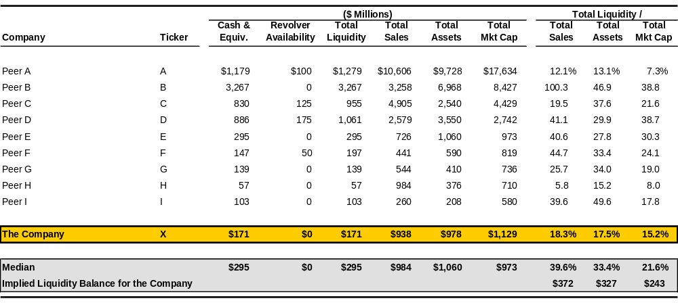
Cash Balances of The Company’s Peers
Cash Balances of Peers
Source: Financials are current or LTM as per companies’ financial reports and Factset.
Note: Medians exclude the Company.
An analysis of close peers suggests a total liquidity balance of $250 to $400 million.

Slide 49
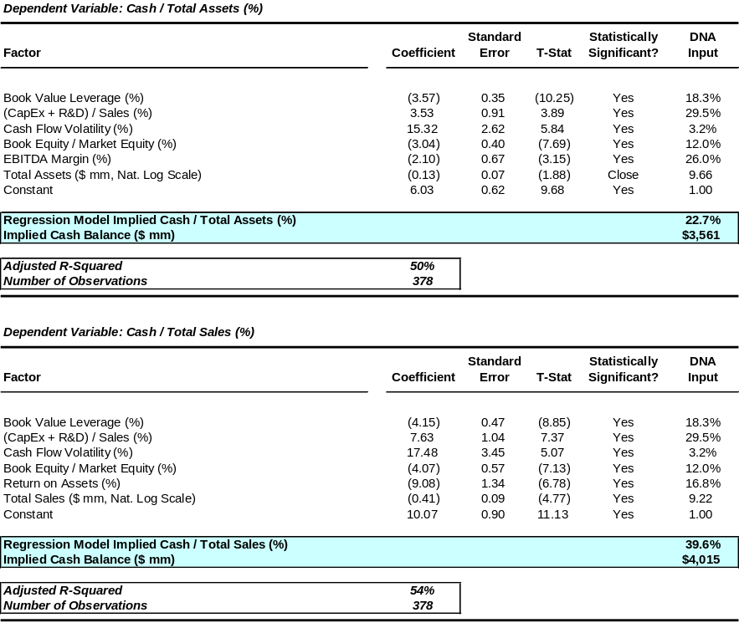
Empirical Drivers of Cash Balances
    Our regression study of the empirical drivers of cash balances (as a percentage of assets and as a percentage of sales) for S&P 500 companies (excluding financial companies) finds that:
      Companies with higher cash flow volatility hold higher cash balances
      Companies with higher capital expenditures and R&D commitments hold larger cash balances
      Larger companies tend to hold proportionately less cash
Drivers of Cash Balances
Note: Analysis assumes a cash flow volatility of 3.2% for the Company, based on historical data since 1990 as per Factset.
Based on the Company’s cash flow volatility, leverage and investment spending, our analysis suggests that the Company should maintain approximately $3.6 to $4.0 billion in cash.

Slide 50
Risk of Liquidity Event: Overview
Free Cash Flow Projections
The model starts with base case projected cash flows. Then, based on the historical distribution of EBITDA / Assets for a broad range of peers, the model simulates projected cash flows using the Monte-Carlo simulation methodology
Cash Accumulation
Assuming a certain level of cash balance today, the model accumulates or drains cash over time depending on the simulated cash flows
Limitations
    Relies on historical cash flow pattern
    Sensitive to cash flow assumptions (e.g. acquisitions)
Our liquidity analysis uses a simulation model which, given the Company’s free cash flow projections, estimates the probability of a liquidity event. A liquidity event is said to occur when the Company’s cash balance falls below zero.

Slide 51

Liquidity Analysis: Results
Probability of an External Liquidity Event in the Next Three Years
Note: Analysis assumes a cash flow volatility of 2.9% based on close peers. Analysis based on free cash flow projections for the Company through 2008, as per Wall Street projections.
A cash balance of $200 million to $250 million⁽¹⁾ would reduce the probability of requiring unforecasted external financing in the next three years to level consistent with the Company’s ‘A’ rating.
(1) Committed but undrawn credit facilities may serve, at least in part, as a replacement for cash.

Slide 52
Shareholder Payout Policy

Slide 53

Shareholder Payout Policy Among The Company’s Peers
Comparable Payout Analysis
  ($ in millions, except per share data)
(1)
(2)
(3)
(4)
The Company’s dividend payout and yield is consistent with its peer median.
Source: Factset, Bloomberg, Wall Street research, companies’ financial reports and our calculations. Market data are as of 03/01/2007.
(1) Mean IBES estimate.
(2) Based on indicated amount.
(3) Last twelve months.
(4) % payout is calculated using payout amount divided by IBES next year’s earnings.

Slide 54



Rate of Return Analysis
Assumptions
Present Value of a Share Repurchase
    Forward EPS projection (I/B/E/S) of $3.020⁽¹⁾
    Forward P/E of 26.5x (based on a stock price of $80.14)
    Long-term EPS growth projection (I/B/E/S) of 27.3%
    The Company’s cost of equity of 10.0%
      Risk free rate of 4.85%⁽²⁾
      Equity market risk premium of 5.5%
      Predicted beta of 0.94⁽³⁾
    Annual dividend of $0.00 per share
(1) Next twelve months’ mean IBES estimate.
(2) 30-year U.S. treasury.
(3) Peer median Barra predicted beta.
Note: The shaded area represents the various growth and P/E scenarios under which the Company’s shares would represent an attractive investment from a return on investment perspective.
IRR — Varying EPS Growth and P/E
IRR — Varying EPS Growth and Repurchase Price
Note: Analysis assumes an average repurchase price of $80.14.
Note: Assumes forward P/E multiple of 26.5x in 5 years.
Under reasonable assumptions, the Company’s shares represent an attractive investment.

Slide 55
Stock Price Effect of Corporate Actions

Slide 56

Cumulative Excess Market Returns Over Time
Median Cumulative Excess Market Return for Follow-Ons, Jan ’00 to Oct ’05
Cumulative Median Excess = 0%
Source: Bloomberg, Factset and our calculations. Data exclude IPOs.
Note: Excess market returns is calculated against the S&P 500 index. Analysis excludes companies whose credit rating declined by more than 3 notches within one year of the announcement and follow-ons where size of the issue is is greater than 75% of the market cap before issuance. S&P rating is the Issuer rating for the quarter prior to announcement day, as per Factset. Analysis includes 246 ‘BBB’ category, 229 ‘BB’ category and 117 ‘B’ category follow-ons in the U.S. since 2000.
On average, it takes a stock anywhere between one month to one quarter following issuance to rebound to its pre-issue level.

Slide 57


Stock Price Reaction to Convertible Bond Issuance with Concurrent Share Repurchase
Market Adjusted Stock Price Reaction to the Announcement of a Convertible Bond Issue
Median Excess Stock Return
Average Excess Stock Return
Source: Factset.
Note: Study includes convertible bond issues since 1/1/2003 (633 observations), of which part of the proceeds were used to repurchase equity in 79 cases. Returns are in excess of S&P 500.
On average, both initially and over the long run, convert issues where part of the proceeds is used to buy back shares tend to exhibit better stock price performance compared to an average convertible issue.

Slide 58




Impact of Spin-Offs: Stock Price Reaction and Volume Traded
Parent: Impact of Announcement⁽¹⁾
Spin-Off: Return Following Spin-Off⁽¹⁾
Announcement Date
Parent: Median Volume Traded⁽²⁾
Spin-Off: Median Volume Traded⁽²⁾
Effective Date
Both the parent and the spun-off companies, on average, outperform the broader market.
(1) Defined as the average excess cumulative total return, including dividends reinvested on the ex-date, over the S&P 500, starting 3 days before the announcement date for the parent company; and on the effective date of the spin-off for the spun-off company.
(2) The reference period for the parent is the 6 months preceding the announcement date of the spin-off. For the spun-off company, the reference period is the 6 months following the effective date of the spin-off.
Source: SDC, Factset as of Q1 2006. Sample set includes 113 spin-offs from 1996 to 2005, valued at at least $75 mm at the time of spin-off.

Slide 59

Optimal Price Considerations
Pre and Post-Split Stock Prices
  Since 2000
Note: Includes forward splits with market capitalizations greater than $100 million since 2000.
Source: FactSet and Bloomberg.
Most stock splits result in a post-split stock price between $20-$40.

Slide 60
Foreign Exchange Exposure Management

Slide 61
Two Opposing Accounting Strategies
IBM’s Strategy
Merck’s Strategy
IBM Europe -
€ Functional Currency
IBM Japan -
¥ Functional Currency
Merck Europe -
$ Functional Currency
Merck Japan -
$ Functional Currency
IBM US -
$ Functional Currency
Merck US -
$ Functional Currency
Consolidate
Consolidate

Slide 62
What Sources of Risk Are Commonly Hedged?
    A 1998 Wharton business survey on corporate risk management revealed that foreign exchange was the most commonly managed risk by non-financial corporations
(1)
Percentage of Sample That Hedges Risk
(2)
The “1998 Survey of Derivatives by U.S Non-Financial Firms,” The Weiss Center for International Financial Research at the Wharton School of Business, University of Pennsylvania.
Examples of equity risk commonly hedged include using collars as part of a share repurchase program, or using total return swaps to monetize equity positions in other companies.
Foreign exchange risk is the most frequently hedged.

Slide 63
What Do Most Companies Hedge?
    85% of corporations hedge anticipated transactions under 1 year, whereas 57% hedge anticipated transactions over 1 year
    Few hedge translation risk
(1)
(1) The “1998 Survey of Derivatives by U.S Non-Financial Firms,” The Weiss Center for International Financial Research at the Wharton School of Business, University of Pennsylvania.
Most companies hedge transaction risk more regularly than translation or economic risk.

Slide 64

Partial Hedging is Prevalent
    The majority of corporations hedge less than 25% of their perceived exposure, regardless of its source
    The more easily identifiable the risk, the higher proportion is hedged
      For example, an average of only 7% of economic risk and competitive exposure is hedged
(1)
(1) The “1998 Survey of Derivatives by U.S Non-Financial Firms,” The Weiss Center for International Financial Research at the Wharton School of Business, University of Pennsylvania.
Corporations tend to partially hedge their exposures.

Slide 65

Dollar Return vs. Risk of Emerging Market Countries
    We examine the monthly returns of a strategy of borrowing in US$, converting the proceeds into selected currencies, investing in the selected country, and then converting the proceeds back to US$
Dollar Return vs. Risk of Emerging Market Countries
Source: IMF, our calculation.
Borrowing in US$ and investing in emerging markets seems to have positive excess returns, at the expense of significant volatility.

Slide 66




Purchasing Power Parity: The Empirical Evidence
Argentina, 1950 - 2004
Chile, 1950 - 2004
Brazil, 1950 - 2004
Mexico, 1955 - 2004
Source: IMF. PPP reflects the initial exchange rate multiplied by the relative price levels. For instance, the PPP implied FX level for the Mexican Peso is the initial actual exchange rate (Peso/$ in 1955) multiplied by (Mexico price level/ US price level).
Purchasing Power Parity seems to hold particularly for high-inflationary economies.

Slide 67




Purchasing Power Parity: The Empirical Evidence
Colombia, 1950 - 2004
India, 1950 - 2004
Turkey, 1955 - 2004
Israel, 1950 - 2004
Source: IMF. PPP reflects the initial exchange rate multiplied by the relative price levels. For instance, the PPP implied FX level for the Mexican Peso is the initial actual exchange rate (Peso/$ in 1955) multiplied by (Mexico price level/ US price level).
Purchasing Power Parity seems to hold particularly for high-inflationary economies.

Slide 68
Cost of Capital

Slide 69




Steel Industry Unlevered Betas
One-Year Historical Beta
Three-Year Historical Beta
Five-Year Historical Beta
Barra Beta
Recommended Midpoint Estimate: 2.02.
Recommended Range: 1.73 – 2.30.
We recommend using the three-year historical industry median beta plus or minus one standard deviation. Please note that the five year historical betas are below the recommended range. As such, bankers may need to use their judgment to adjust betas based on their own assessment of industry conditions.
Note: The historical beta graphs display the recommended beta estimate and a range of one standard deviation around it. The historical beta graphs also display the beta of each peer along with a two standard deviation range around them. The two standard deviation range around the Barra betas of peers is based on the median observation’s three-year standard deviation. The one standard deviation range around the Barra industry median beta is based on the standard deviation of the median observation.

Slide 70




Technology Industry Unlevered Betas
One-Year Historical Beta
Three-Year Historical Beta
Five-Year Historical Beta
Barra Beta
Recommended Midpoint Estimate: 1.43.
Recommended Range: 1.21 – 1.64.
Betas in this industry appear to be robust. We recommend using the three-year historical industry median beta plus or minus one standard deviation.
Note: The historical beta graphs display the recommended beta estimate and a range of one standard deviation around it. The historical beta graphs also display the beta of each peer along with a two standard deviation range around them. The two standard deviation range around the Barra betas of peers is based on the median observation’s three-year standard deviation. The one standard deviation range around the Barra industry median beta is based on the standard deviation of the median observation.

Slide 71




Pharmaceuticals Industry Unlevered Betas
One-Year Historical Beta
Three-Year Historical Beta
Five-Year Historical Beta
Barra Beta
Recommended Midpoint Estimate: 0.72.
Recommended Range: 0.58 – 0.86.
Betas in this industry appear to be robust. We recommend using the three-year historical industry median beta plus or minus one standard deviation.
Note: The historical beta graphs display the recommended beta estimate and a range of one standard deviation around it. The historical beta graphs also display the beta of each peer along with a two standard deviation range around them. The two standard deviation range around the Barra betas of peers is based on the median observation’s three-year standard deviation. The one standard deviation range around the Barra industry median beta is based on the standard deviation of the median observation.

Slide 72

Recommended Industry Beta Ranges
Summary of Beta Ranges
The smallest beta range across the industries studied is Energy with a range of 0.54 to 0.72, while the largest is Solar Energy with a range of 1.18 to 2.31.

Slide 73
International Cost of Capital

Slide 74
International Cost of Capital
    U.S. dollar returns on emerging market equities primarily are a function of returns on the broad U.S. equity market (e.g., the S&P 500) and on the corresponding emerging country’s U.S. dollar-denominated bonds (e.g., Bradys or Yankees)
    Cost of capital for an investment in an emerging economy is a combination of the cost of capital of a similar U.S.-based investment and the specified emerging country’s international borrowing cost
    Returns on emerging country stocks which are widely followed in the U.S. Market (e.g., Teléfonos de México, Telefónica de Argentina and YPF) are statistically dependent on returns in the broad U.S. market
      Conversely, returns on emerging country stocks which may be less followed, or traded, in the U.S. market (e.g., Corimon and Banco Ganadero) are not statistically dependent on returns in the broad U.S. market
    As macroeconomic conditions in an emerging economy become more volatile, U.S. dollar returns on a specified foreign equity start becoming more statistically dependent on the specified country’s bond returns
      Conversely, returns on equities of relatively stable countries (e.g., Chile) are not statistically dependent on returns of the country’s corresponding U.S. dollar-denominated bonds.

Slide 75

International Cost of Capital (Cont’d.)
    Returns on emerging market American Depository Receipts are often closely related to returns on various Brady or Yankee bonds, as well as to the S&P 500
      However there are a few exceptions, such as ADRs issued by countries e.g. Chile which are investment-grade rated by at least one credit-rating agency
    The evidence supports the hypothesis that if a country is macroeconomically stable, its ADRs are not affected by returns on its bonds
Sensitivities of Emerging Market ADRs to S&P 500 and Corresponding Bonds⁽¹⁾
(1) The regressions are based on daily data from January 1994 – September 1996.

Slide 76

Political Risk Premium Summary
    We adjust WACC for risks associated with a particular country by introducing political risk premium (“PRP”)
      The political risk premium represents the incremental return investors require for use of their funds in international investments and represents non-systematic risks such as expropriation
      The political risk premium is estimated using a country’s credit rating, its Index of Economic Freedom (“IEF”) as well as trading data on its international bonds
    As a simplification, a country’s international bonds spreads can be used as a proxy for its political risk premium. While it is a market based approach, it introduces volatility in cost of capital estimates as spreads are affected by numerous factors
      For example, for a number of countries sovereign spreads recently have been at historical lows
        One reason for this phenomena may be relatively low interest rates in the US which may force yield-hungry investors to buy emerging market bonds
        Yet another reason may be a pick-up of the global economy
    The table below represents PRP estimates:

Slide 77


Current Spreads vs. Sovereign Credit Ratings
Spread (bps, ln scale) = 6.16 – 0.15 x Sovereign Credit Rating⁽¹⁾
R-Squared = 85%
Values which are less than or equal to the 10th percentile
Note: The yellow trend line is the fitted line for the regression.
(1) Sovereign credit rating is expressed as a number ranging from 18 (“AAA”) to 1 (“CCC”).
Values which are greater than or equal to the 90th percentile
There is a strong statistical relationship between countries’ credit ratings and their bond spreads.

Slide 78


Current Spreads vs. Index of Economic Freedom
Spread (bps, ln scale) = 7.20 – 0.04 x Index of Econ Freedom⁽¹⁾
R-Squared = 30%
Values which are less than or equal to the 10th percentile
Note: The yellow trend line is the fitted line for the regression.
(1) Index of Economic Freedom is expressed as a number ranging from 0 to 100, where 100 represents the maximum freedom.
Values which are greater than or equal to the 90th percentile
There is a statistical relationship between countries’ Index of Economic Freedom and their bond spreads.
Note: Index of Economic Freedom is jointly published by Heritage Foundation and the Wall Street Journal. Spread data are vs. US Treasury.

Slide 79

Statistical Determinants of Political Risk
    A country’s Index of Economic Freedom and credit rating are strong statistical drivers of our political risk premium estimates
      Countries with more economic freedom and higher ratings have lower political risk
PRP (ln scale) = 5.824 – 0.008 x Index – 0.164 x Credit Rating
(0.337) (0.007) (0.016)
R-Squared = 85%
Note: The yellow trend line is the fitted line for the regression. Analysis based on February 2007 data.
A country’s Index of Economic Freedom and credit rating are strong statistical drivers of our political risk premium estimates.

Slide 80
Conglomerate Discounts

Slide 81
Why Conglomerate?
Pros
Cons
Greater operating efficiency
Better access to capital with size
Political access
Increased debt capacity
Lower average taxes
Leveraging managerial talent
Better at undertaking positive NPV projects
Poor operating efficiency
Difficulty in aligning management initiatives
Poor head office supervision
Lack of transparency
Failure to address investor segmentation
Lack of takeover premium in the stock
Cross-subsidization of poorly performing segments
Greater likelihood of negative NPV investments
Theoretical reasoning alone cannot predict whether conglomerates create or destroy value. The question needs to be settled empirically.

Slide 82
Spin-Offs vs. Carve-Outs
Spin-Offs
Carve-Outs
Distribution of subsidiary stock
Underperformers are spun off
Subsidiaries with large revenues and low valuations are spun off
Positively correlated with the M&A market
Negatively correlated with the S&P
Moderate declines in operating performance post spin-off
IPO of subsidiary stock
Star performers are carved out
Subsidiaries with small revenues and high valuations are carved out
Positively correlated with the M&A market
Positively correlated with the S&P
Maximized operating performance pre carve-out
Typically, underperformers are spun off; whereas jewels are carved out.

Slide 83
The Empirical Evidence
Spin-Offs
Carve-Outs
Parent excess returns of 4% on announcement
Daughter mid-term excess return of 6%
Daughter long-term excess return of 25%
Parent long-term mean excess return of 15%
Daughter acquisition probability of 25%
Negligible excess return for parent on announcement
Daughter mid-term excess return of 21%
Daughter long-term excess return of 36%
Parent long-term mean excess return of 14%
Daughter acquisition probability of 22%
Both spins and carves exhibit positive excess returns (though carves enjoy a lead) and have a high likelihood of being acquired.

Slide 84


The U.S. Evidence
How diversified are U.S. firms?
EBIT / Sales⁽¹⁾
95% of US companies have at most 4 business segments
Most pure plays have higher EBIT margins than diversified companies
(1) Median for each group.
Source: Factset/Worldscope as of Q2 2005. Analysis includes a total of 3,142 US companies with total sales of at least $100 mm and listed on a major US exchange (NYSE, Nasdaq, AMEX).
Note: The small sample size (General Electric, a significant outlier, Berkshire Hathaway, Leucadia and Masco) skews the analysis for companies with eight business segments.
Pure play companies tend to have higher margins.

Slide 85


The U.S. Evidence
EV / EBITDA
EV / Sales
Note: Other factors such as leverage, growth, size and industry might account for these discounts. We conducted statistical studies to determine the relationship between underperformance and these factors and found that the degree of conglomeration still had a significant impact on underperformance.
Graphs represent medians for each group.
The small sample size (General Electric, a significant outlier, Berkshire Hathaway, Leucadia and Masco) skews the analysis for companies with eight business segments.
Source: Factset/Worldscope as of Q2 2005. Analysis includes a total of 3,142 US companies with total sales of at least $100 mm and listed on a major US exchange (NYSE, Nasdaq, AMEX).
Diversified companies trade at a discount of about 8% to 24% compared to their pure play peers.

Slide 86


The European Evidence
How diversified are European firms?
EBIT / Sales⁽¹⁾
85% of European companies have at most 4 business segments
Pure plays tend to have higher EBIT margins
(1) Median for each group.
Source: Factset/Worldscope as of Q2 2005. Analysis includes a total of 2,444 European companies with total sales of at least €80 mm.
European companies tend to be slightly more diversified than their US counterparts.

Slide 87


The European Evidence
EV / EBITDA
EV / Sales
Note: Other factors such as leverage, growth, size and industry might account for these discounts. We conducted statistical studies to determine the relationship between underperformance and these factors and found that the degree of conglomeration still had a significant impact on underperformance.
Graphs represent medians for each group.
Source: Factset/Worldscope as of Q2 2005. Analysis includes a total of 2,444 European companies with total sales of at least €80 mm.
European diversified companies tend to trade at similar discounts (5%-25%) to their US counterparts.

Slide 88


Successful Conglomerates
Enterprise Value / EBITDA for Selected Industrial Conglomerates
(1)
(1) Median of 160 US industrial companies with only one business segment.
Source: Factset/Worldscope as of Q2 2005.
Successful conglomerates tend to have a distinctive persona, or comparative advantage.

Slide 89



Closed-End Fund Performance
    The Closed-end fund discount has been a significant source of academic debate; similar to the conglomerate discount.
    Closed-end fund managers may face issues similar to conglomerate managers.
Premium/Discount of CEFs
Median: -3.3%
Mean: -1.6%
Std. Dev.: 9.5%
Source: Closed End Fund Forum. Analysis includes 227 closed-end funds.
Historical Average Discount in the US
Historical Average Discount in the UK
Closed-end funds trade at discounts of up to 10%.
Source: Dimson and Minio-Paluello, “The Closed-End Fund Discount”, AIMR and Blackwells, 2003.

Slide 90




Market Trends
Total M&A Activity and Spin-Offs: Announced Transactions⁽¹⁾
(1) Based on SDC data since 1990.
Source: SDC, Factset.
While spin-offs are positively correlated with general corporate M&A activity, stronger equity market conditions seem to result in a preference for M&A over spin-offs.

Slide 91




Market Trends
Total M&A Activity and Equity Carve-Outs: Announced Transactions⁽¹⁾
(1) Sample set includes 113 spin-offs from 1996 to 2005, valued at at least $75 mm at the time of spin-off and 125 carve-out transactions from 1997 to Q2 2005, with the market value of the carve-out offer valued at at least $20 mm.
Source: SDC, Factset.
Carve-outs are more frequent during periods of better equity and M&A market conditions.

Slide 92




Industry Distribution of Spin-Offs and Carve-Outs
Parent Company of Spin-Off
Spun-Off Company
Parent Company of Carve-Out
Carved-Out Subsidiary
Historically, equity carve-outs are used in all industries, but are especially popular in the technology sector, while spin-offs are more evenly distributed.
Source: SDC, Factset as of Q1 2006.
Note: Sample set includes 125 carve-outs from 1997 to Q2 2005, with the market value of the carve-out offer valued at at least $20 mm, and 113 spin-offs from 1996 to 2005 valued at at least $75 mm at the time of spin-off.

Slide 93



Post Transaction Activity
Spin-Offs Today
Carve-Outs Today
(1)
Acquisitions and Repurchases of Spun-Off/Carved-Out Subsidiaries⁽²⁾
A majority of both spin-offs and carve-outs tend to operate successfully and have a high likelihood of being acquired.
(1) Parent retained a minority stake of above 10%.
(2) Chart shows percentage of subsidiaries acquired or repurchased among all spin-offs or carve-outs.
Source: SDC, Bloomberg.
Note: Sample set includes 113 spin-offs from 1996 to 2005, valued at at least $75 mm at the time of spin-off and 125 carve-out transactions from 1997 to Q2 2005, with the market value of the carve-out offer valued at least $20 mm.

Slide 94




Spin-Offs, Carve-Outs and Operating Performance
Return on Assets: Spin-Offs
Parent Company
Spin-Off
Return on Assets: Carve-Outs
Parent Company
Equity Carve-Out
Companies appear to maximize operating performance at their subsidiaries prior to a carve-out in order to achieve the best valuation. Spun-off companies experience moderate declines in their operating performance.
Source: SDC, Factset as of Q1 2006. Sample set includes 113 spin-offs from 1996 to 2005, valued at at least $75 mm at the time of spin-off, and 125 carve-out transactions from 1997 to Q2 2005, with the market value of the carve-out offer valued at least $20 mm.
Note: Return on assets is computed as EBITDA / Total Assets for the given year.

Slide 95
Impact of Spin-Offs: Stock Price Reaction and Volume
Parent: Impact of Announcement⁽¹⁾
Spin-Off: Return Following Spin-Off⁽¹⁾
Announcement Date
Parent: Median Volume Traded⁽²⁾
Spin-Off: Median Volume Traded⁽²⁾
Effective Date
Both the parent and the spun-off companies, on average, outperform the broader market.
(1) Defined as the average excess cumulative total return, including dividends reinvested on the ex-date, over the S&P 500, starting 3 days before the announcement date for the parent company; and on the effective date of the spin-off for the spun-off company.
(2) The reference period for the parent is the 6 months preceding the announcement date of the spin-off. For the spun-off company, the reference period is the 6 months following the effective date of the spin-off.
Source: SDC, Factset as of Q1 2006. Sample set includes 113 spin-offs from 1996 to 2005, valued at at least $75 mm at the time of spin-off.

Slide 96




Return Distributions for Spin-Offs
Spin-Off
Spin-Off (Spin-Off Value Over $1 Billion)
Parent Company
Parent (Spin-Off Value Over $1 Billion)
Regardless of size, spin-offs are followed by the emergence of a population of “winners” and “losers.”
Note: Excess return is computed over the S&P 500 index.
Source: SDC, Factset as of Q1 2006. Sample set includes 113 spin-offs from 1996 to 2005, valued at at least $75 mm at the time of spin-off, out of which 42 were valued at over $1 billion.

Slide 97




Impact of Carve-Outs: Stock Price Reaction and Volume
Median Excess Market Return for Carve-Outs⁽¹⁾
Median Return for High Multiple Carve-Outs⁽²⁾
Parent: Median Volume Traded⁽³⁾
Carve-Out: Median Volume Traded⁽³⁾
Effective Date
Since 2001, equity carve-outs have outperformed the broader market.
(1) Excess return is computed over the S&P 500 index, starting the day prior to the announcement date for the parent and the IPO date for the carve-out.
(2) Defined as the Firm Value / EBITDA multiple starting at least 1.0x higher for the carve-out than for the parent (at the time of carve-out). Excess return is computed over the S&P 500 index, starting the day prior to announcement date for the parent and the IPO date for the carve-out.
(3) The reference period for the Parent is 6 months preceding the announcement date of the carve-out. For the carved-out company, the reference period is 6 month following the effective date of the carve-out.
Source: SDC, Factset as of Q1 2006. Sample set includes 29 carve-outs (6 high multiple) above $20 million, announced after January 1, 2001.

Slide 98


Impact of Carve-Outs: Stock Price Reaction
Median Excess Market Return⁽¹⁾
for Carve-Outs: IPO of Up to 20% of Subsidiary
Median Excess Market Return⁽¹⁾
for Carve-Outs: IPO of Less than 50% of Subsidiary
Equity carve-outs of minority stakes in subsidiaries have also performed strongly.
(1) Excess return is computed over the S&P 500 index, starting the day prior to the announcement date for the parent and the IPO date for the carve-out.
Source: SDC, Factset as of Q1 2006. Sample set includes 18 carve-outs with a minority stake above $20 million sold, announced after January 1, 2001, of which 6 sold 20% or less of the subsidiary.
Note: The main analysis focuses on all subsidiary IPOs, but for tax reasons equity carve-outs up to 20% or for control reasons equity carve-outs less than 50% are also important subsets.

