Slide 1
Optimal Capital Structure: Taxes, Bankruptcy Costs and Agency Effects
Using the Adjusted Present Value Method (APV)

Slide 2
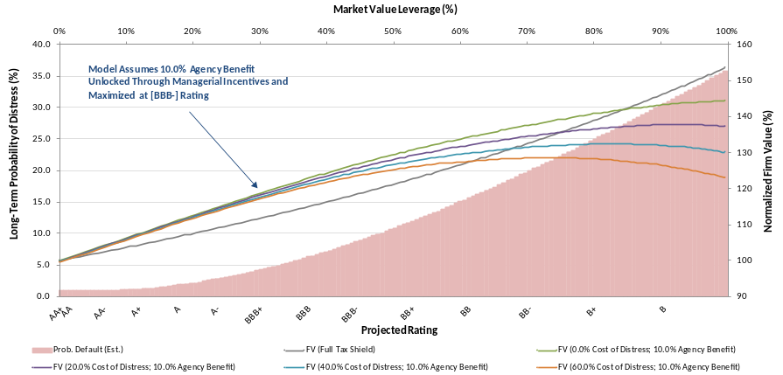
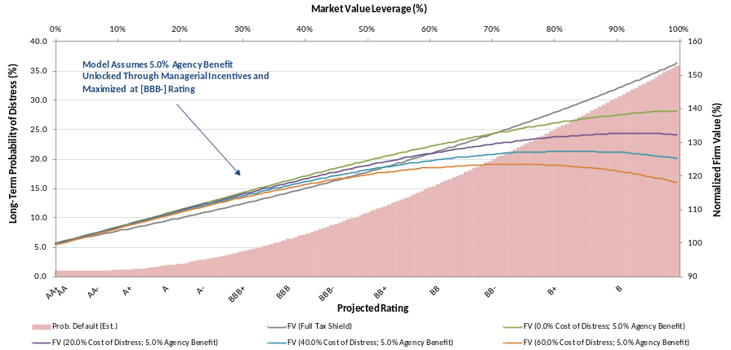
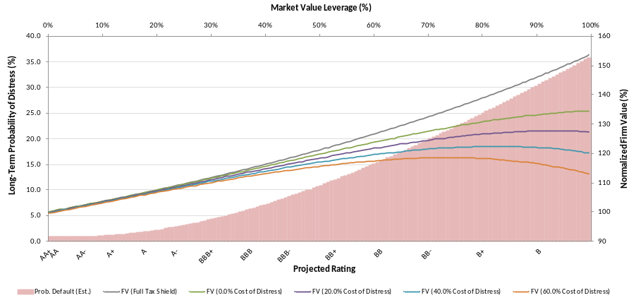
Optimizing Firm Value in the Presence of Taxes, Distress Costs and Agency Benefits
Firm Value Assuming 10% Agency Benefit
Firm Value Assuming 5% Agency Benefit
Financial theory suggests that an ideal capital structure optimizes the trade off between the net present value of the tax shield, agency benefits and the negative impact of distress costs
Additional benefits of leverage subsumes improved managerial performance and reduction in excessive investments, identified in these charts as “agency benefit”
These graphs abstract from the various other costs and benefits of debt described in the literature
Firm Value Assuming No Agency Benefit
Note: Credit Rating estimates are based on a statistical relationship between ratings and market value leverage. Agency benefits assumed to peak at BBB- rating. Default probabilities are taken from Standard & Poor’s

Slide 3
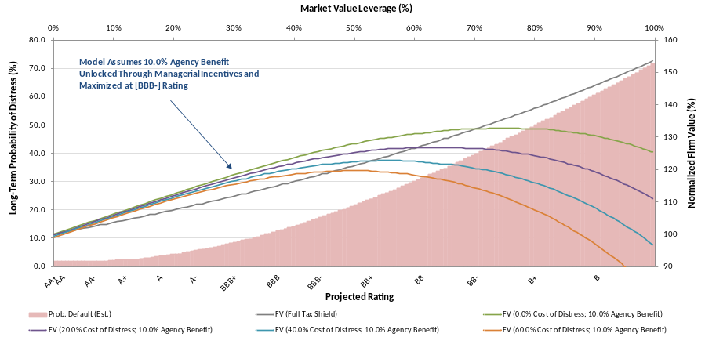

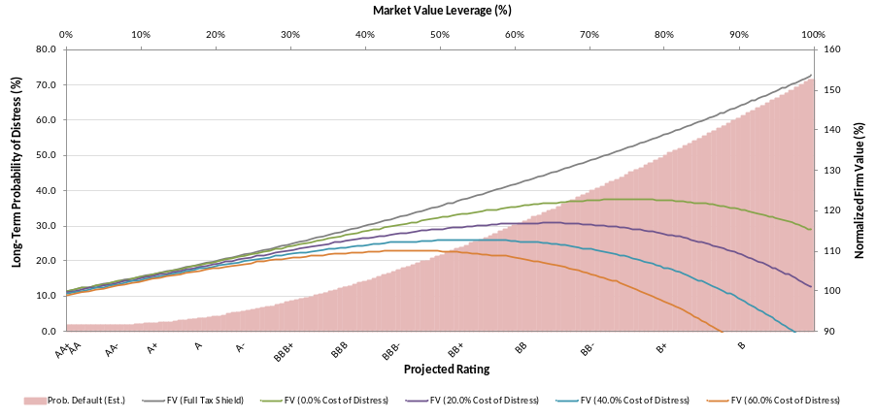
Optimizing Firm Value in the Presence of Taxes, Distress Costs and Agency Benefits (Cont’d)
Firm Value Assuming 10% Agency Benefit
Firm Value Assuming 5% Agency Benefit
Firm Value Assuming No Agency Benefit
In times of recession, corporate default rates can increase dramatically
Adjusting probability of default for recessionary periods moves the optimal leverage point closer to BBB/BBB-, when assuming 60% of firm value as the cost of distress
Note: Credit Rating estimates are based on a statistical relationship between ratings and market value leverage. Agency benefits assumed to peak at BBB- rating. Default probabilities are taken from Standard & Poor’s

