Slide 1
US Macroeconomic Outlook,
Funding Strategies,
and a Sixty-Year History of Markets
By Niso Abuaf
July 2013

Slide 2
1. | US Macroeconomic Outlook
2. | Efficient-Frontier Funding Strategies
3. | A Sixty-Year History of Interest Rates
4. | History of Economic Growth: GDP and the Stock Market
Notes:
2

Slide 3
Executive Summary
The US Macro Outlook and Efficient Funding Strategies
The current macroeconomic outlook presents a duality: exceedingly low short-term interest rates in the medium term, offset by inflation and correspondingly higher interest-rate risk due to globally ballooning Central Bank balance sheets. Federal Open Market Committee (FOMC) forecasters’ views show that the fed-funds rate has a central tendency of 4%–2% real rate plus 2% inflation only beyond 2015.
According to the well-known Okun rule, GDP has to grow by approximately two percentage points over and above its run-rate to soak up one percentage point of unemployment. This rule means that for unemployment to fall to its steady-state level of 5%, GDP has to grow by 9% in one year or by 4% for six years (assuming that the run rate of GDP is 3% per year). This is not happening!
The main reasons behind this very low interest-rate environment are twofold: first, the unemployment rate is significantly higher than its steady state level (slightly below 8% versus 5%), and second inflation is not significantly higher (maybe even lower depending on how you measure it) than its policy level of about 2% to 2.5% p.a.
  The Federal Reserve follows some version of the frequently-cited Taylor rule, or framework , which suggests that the Fed-Funds rate equals the long-run real rate (about 2%) plus the steady-state inflation rate (approximately 2% to 2.5%) and a weighted average of the gross domestic product (GDP) gap and the inflation gap. Though there are many interpretations of the Taylor rule, most economists would agree that the current environment implies a very low or even negative Fed Funds rate, and that the environment will remain as such until the unemployment rate is on its way to reaching its full-employment level.
  Currently the Federal Reserve is using two instruments of monetary policy
    The Fed-Funds rate (stressing not time forecasts, but data dependent forecasts)
    Purchases of Treasuries and Agencies (to taper or not?)
  Under normal circumstances such an increase in base (or high-powered) money would have resulted in significant levels of inflation. Currently, however, because the money multiplier has declined significantly due to the 2007-2009 contraction, M1 and M2 have not grown as fast as high-powered money. And, heretofore inflation has not materialized. Nonetheless, global economic history suggests that inflation may hit suddenly and violently. Thus, this is the current macroeconomic duality: very low interest rates projecting into the medium-term future offset by high-levels of inflation risk.

Slide 4
Executive Summary
The US Macro Outlook and Efficient Funding Strategies
This duality intuitively suggests that an optimal funding strategy might consist of short term borrowings (to exploit the low short-term rates) coupled with long-term borrowings (to hedge against rising inflation and interest rates).
In this presentation, we empirically demonstrate that a barbell funding strategy is indeed on the efficient frontier, and most efficient frontier strategies consist of the barbell plus the 5-year, particularly under increased liquidity or funding risk eventualities. Once we delineate the barbell with episodic inclusions of the 5-year, the Chief Financial Officer (CFO) can choose the optimal fixed versus floating mix based on his pain tolerance for declines in earnings per share (EPS) given the likely moves in short-term rates.
In addition to pain tolerance considerations in choosing his fixed versus floating strategy, the CFO also looks at comparable analysis of the industry he is operating at. Various industries will have differing fixed versus floating characteristics depending on their capital structures and the sensitivity of the particular industry to interest rates.
Most CFOs that I have had conversations with state that the most important choice in liability management is the fixed versus floating mix and not the maturity mix. Nonetheless, I posit that the maturity mix should be predicated on an efficient frontier type analysis combined with a probabilistic and economic determination of which instrument would be the likely winner over a planning horizon.

Slide 5
Executive Summary
The US Macro Outlook and Efficient Funding Strategies
A major caveat for floating-rate funders is that interest rates can jump violently. For example, in the period from 1990 to the present, we have experienced three major periods where short-term rates (3M Libor) have moved significantly over a few years
  3.19% (2/93) to 6.50% (12/94), or 331 bps in one year ten months.
  4.97% (1/99) to 6.81% (9/00), or 184 bps in one year eight months.
  1.11% (3/04) to 5.48% (6/06), or 437 bps in two years and three months.
On the good news side, corporate spreads are negatively correlated with quarter-on-quarter annualized percentage changes in GDP (R² of 59%). In this respect, the CFO is partially hedged in that when the economy does well, the risk-free rate will likely go up, but credit spreads will likely go down; and conversely.

Slide 6
Executive Summary
A Sixty-Year History of Interest Rates
When analyzing the history of interest rates, we have to bear in mind that the nominal interest rate consists of three building blocks.
  The real rate of interest (i.e. inflation adjusted, or TIPS)
  Inflationary expectations
  Credit Spreads
The long term real rate of interest approaches long-term GDP growth, both of which converge to 3% per year.
Because the short-term interest rate approaches 2% in the long-run, we conclude that the TIPS yield curve has a 100 bps spread (3M-30Y) under normal conditions.
We present the statistical distributions of various interest rate spreads in the graphs that follow.
Conventional wisdom suggests that the yield curve flattens before a recession, and steepens during a recession.

Slide 7
Executive Summary
GDP and the Stock Market
S&P 500 Real Earnings are about 100(mean) – 250(median) bps higher than real GDP growth. This may suggest that throwing out underperformers may improve portfolio returns significantly.
As expected, S&P 400 Real Earnings are higher than that of the S&P 500. Specifically, S&P 400 Real Earnings are about 7% higher than real GDP growth.
Investors may use various metrics such as the P/E multiple to ascertain whether the stock market is rich or cheap.
The Capital Asset Pricing Model is the classic academic model used for stock valuation. As such practitioners universally rely on betas and their decomposition into correlation and relative volatility.
When discussing share repurchase assignments, cost of capital considerations, and equity valuation with clients, we spend considerable time on the robustness and components of beta; and the equity market risk premium.

Slide 8
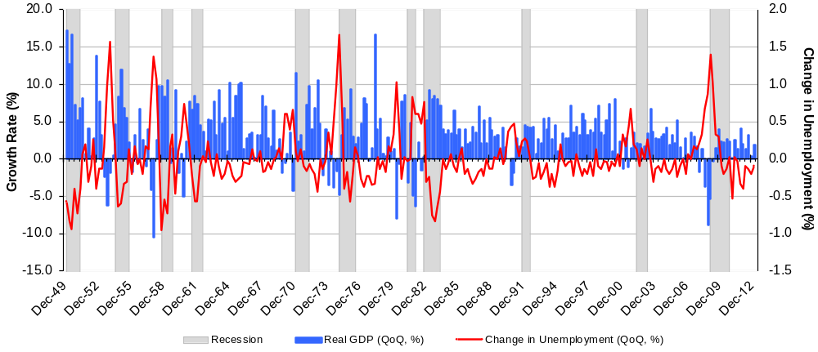
Economic Growth Leads the Unemployment Rate and is More Volatile – The Okun Rule
US Unemployment Rate and Rate of Growth of U.S. GDP, Dec 1949 – Mar 2013
  GDP growth = 3.33 – 1.82*(change in unemployment)
  t statistics: (18.22) (15.38)
  Adj. R² = 48.50%
  This confirms the study by Abel and Bernanke, 2005
Source: Bloomberg.
Notes:
8

Slide 9
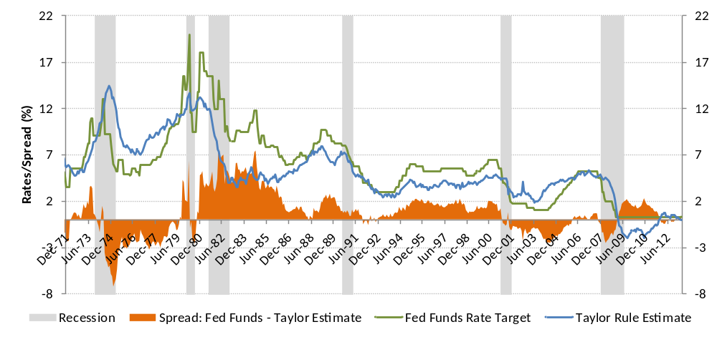
The Fed’s Reaction Function and the Taylor Rule, 1971-2013
Following the bursting of the TMT bubble, the Fed kept rates lower than the Taylor rule to fight dreaded deflation
  The Taylor rule is widely used to explain Fed-fund targets rates
    Real Rate+Core Inflation+½*(Inflation–Target Inflation)+½*Okun Factor*(Normal Unemployment–Unemployment)
  In the recent past, with unusually high unemployment and low inflation, the rule called for negative rates
    This is yet another indication that short rates may stay low for some time
Source: Bloomberg, NBER.
Notes:
9

Slide 10
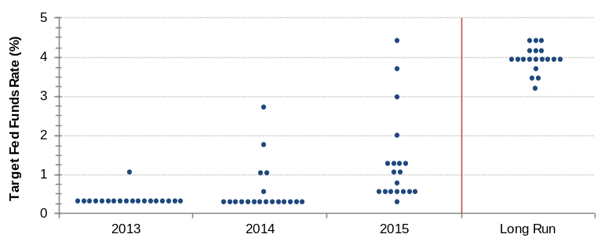
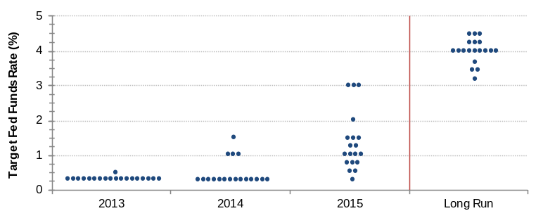
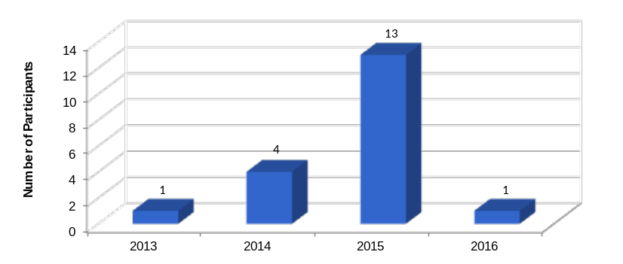
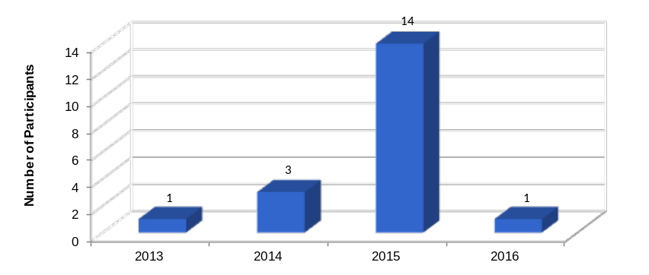
FOMC Overview of Monetary Policy
Since its December 2012 meeting, FOMC maintained that low rates are appropriate at
least as long as the unemployment rate remains above 6-1/2%, inflation between one and two years ahead is
projected to be no more than a half percentage point above
the Committee's 2% longer-run goal, and longer-term
inflation expectations continue to be well anchored.
FOMC Outlook on Pace of Policy Firming
March 2013
June 2013
FOMC Outlook on Timing of Policy Firming
March 2013
June 2013
Note: March & June 2013 Minutes
Source: Federal Reserve
Page 10
Notes:
10
10

Slide 11
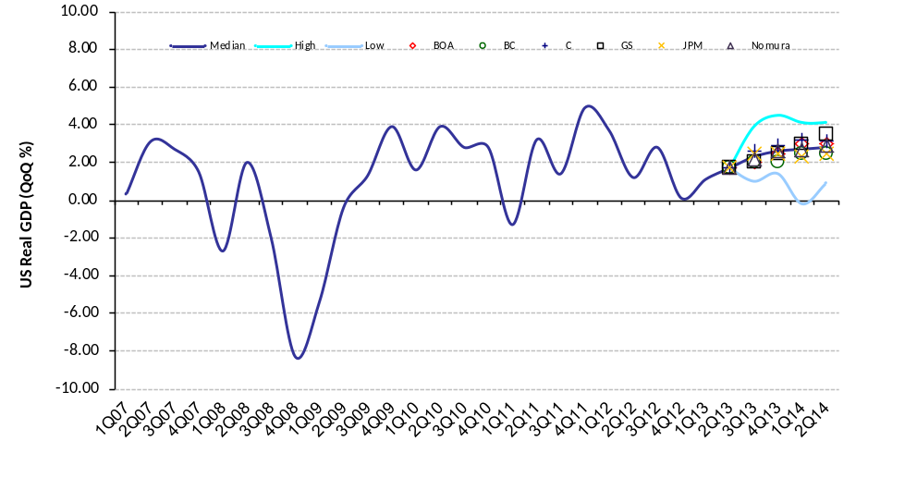
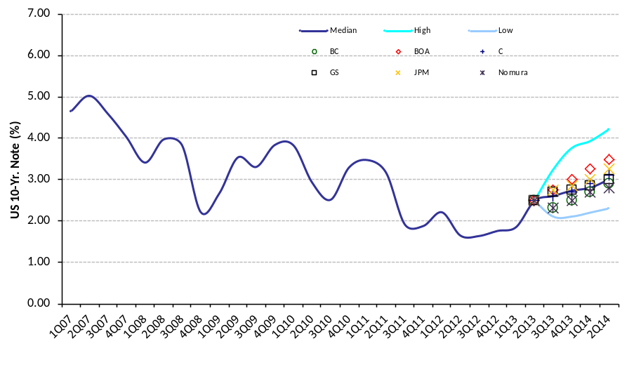
Economic Forecasts
Historical & Forecasted US Real GDP Growth Rate, 1Q07 – 2Q14
Historical & Forecasted 10-Year Treasury Rate, 1Q07 – 2Q14
Bloomberg consensus and the selected economists project that the economy will continue expansion in 2013, albeit with a slow starting 2013
Most forecasters are optimistic because they think that the negative effects of sequestration will wear off, adding 100–150 bps to GDP; in addition to good news about US energy supplies.
Note: Upper and lower bounds represent Bloomberg’s survey of approximately 80 economists
Source: Wall Street research, Bloomberg.
Page 11

Slide 12
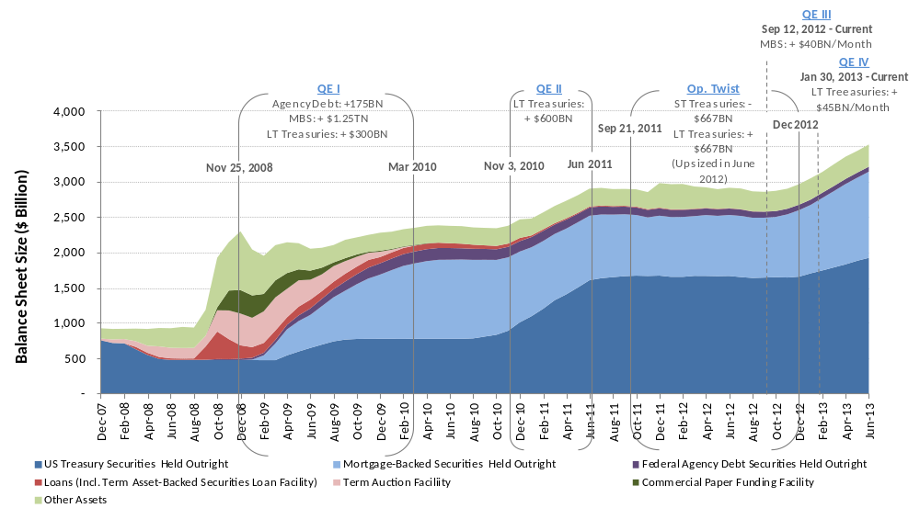
US Money Supply Growth (Assets of the Fed)
Federal Reserve Balance Sheet Size, Dec 2007 – Jul 2013
Following the onset of the financial crisis, the Federal Reserve used a variety of tools at its disposal to stimulate economic growth and pump liquidity into the financial sector. As a result of the Fed’s open market operations (OMOs), by the end of 2012 the size of the Federal Reserve balance sheet has tripled
As of the end of June 2013, the Fed is continuing to purchase $40 billion of MBS and $45 billion of LT Treasury securities on a monthly basis, accounting for about 7.5% of the US annual nominal GDP. In comparison, the US budget deficit peaked in 2009 at around 10% of annual GDP and has since been steadily declining. As of Mar 2013, the US budget deficit was 5.7% of the nominal GDP, on an annualized basis
Note: Other assets = Repo agreements + assets related to the financial crisis + central bank liquidity swaps + other assets + gold + special drawing rights + treasury currency
Source: Bloomberg

Slide 13
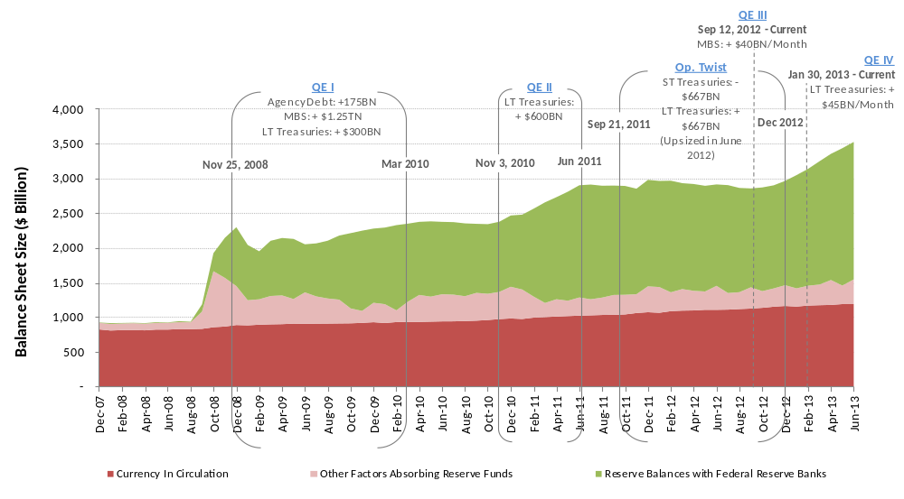
US Money Supply Growth (Liabilities of the Fed)
Federal Reserve Liabilities, Dec 2007 – Jul 2013
The expansion of the Federal Reserve’s balance sheet since the onset of the financial crisis has been matched on the liabilities side primarily through the expansion in deposits of depository institutions
Source: Bloomberg

Slide 14
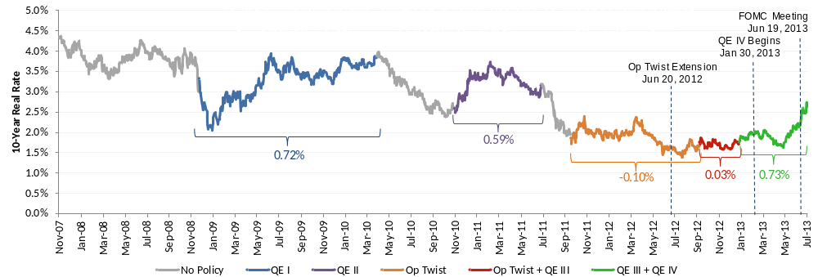
Interest Rate Environment Following the Financial Crisis
10-Year Nominal Interest Rate, Nov 2007 - Jul 2013
  Economists surmise the following:
    QE during extreme crisis has been more effective than at other times
    QE has diminishing marginal returns
    The question is: when are diminishing marginal returns offset by marginal costs?
Source: Bloomberg, Federal Reserve.
Notes:
14
14

Slide 15
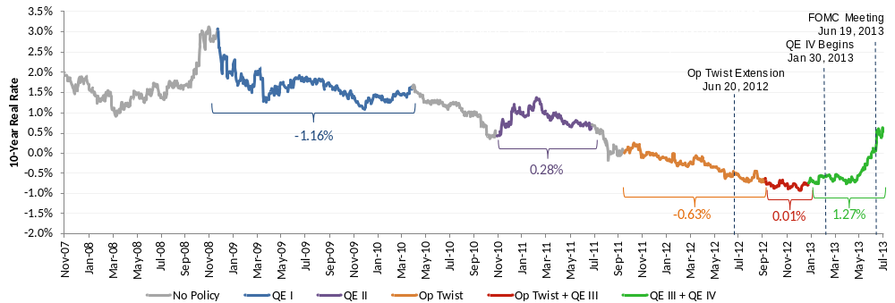
Interest Rate Environment Following the Financial Crisis
10-Year Real Rate Interest (TIPS), Nov 2007 - Jul 2013
  Real rates have been steadily declining following the recession. We observe that in the long-run, real rates loosely match the growth in GDP. 2010 to date, the US GDP growth rate has hovered in the vicinity of 2%, yet the 10-year TIPS rate has been substantially below that mark
  Even with the recent pullback, real rates remain considerably below their long-term average of 2.5%. It appears that the Fed’s aggressive asset purchase response to the financial crisis manifested itself primarily through severe compression in the real rates, which would also explain the violent spike in rates following the QE taper talks
Source: Bloomberg, Federal Reserve.
Notes:
15
15

Slide 16
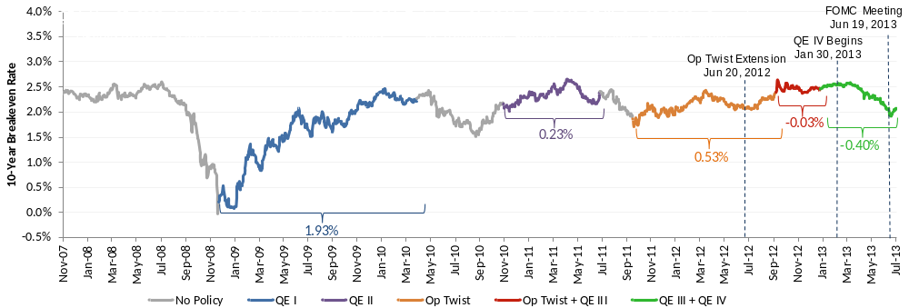
Interest Rate Environment Following the Financial Crisis
10-Year Breakeven Rate (Inflationary Expectations), Nov 2007 - Jul 2013
  10-year breakeven rates have generally risen through the QE periods and have decreased in the periods between Fed asset purchases, probably reflective of the expansive monetary policy needed to sustain additional asset purchases
  Since May 1st and the beginning of the tapering talks, the breakeven 10-year rate has declined by 25 bps. 10-year expected inflation is currently at 2%, below historical average change in Core CPI (CCPI), but in-line with Fed’s current target inflation rate
Source: Bloomberg, Federal Reserve.
Notes:
16
16

Slide 17
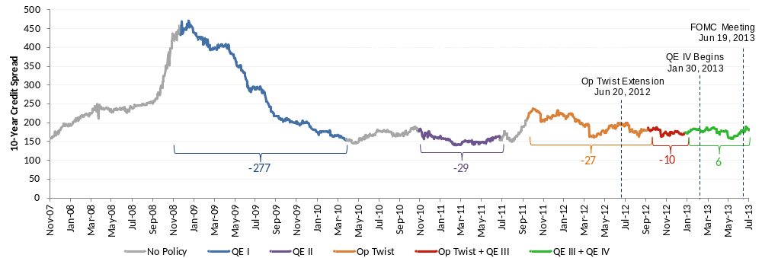
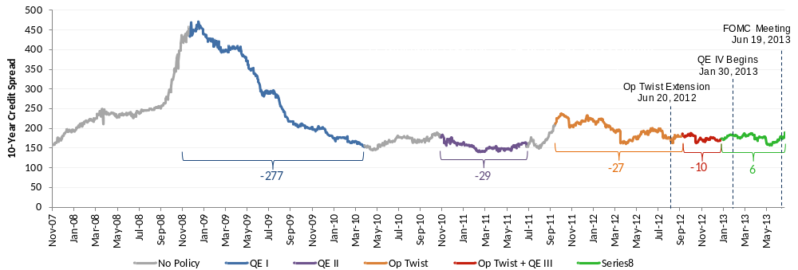
Interest Rate Environment Following the Financial Crisis
10-Year BBB Industrial Credit Spread, Nov 2007 - Jul 2013
  10-year credit spreads contracted sharply during QE I, which coincided with the end of the recession and have remained relatively stable subsequent to that. Still, we can observe credit spreads tightening during QE periods and widening in-between QE periods, possibly reflective of the downward pressure on rates caused by the Fed asset purchases
Source: Bloomberg, Federal Reserve.
Notes:
17
17

Slide 18
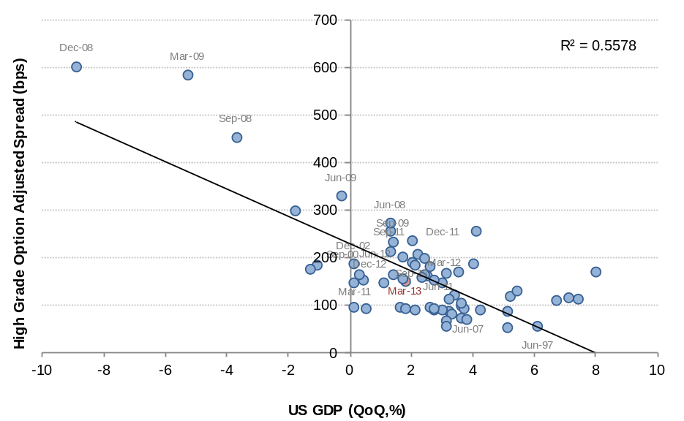
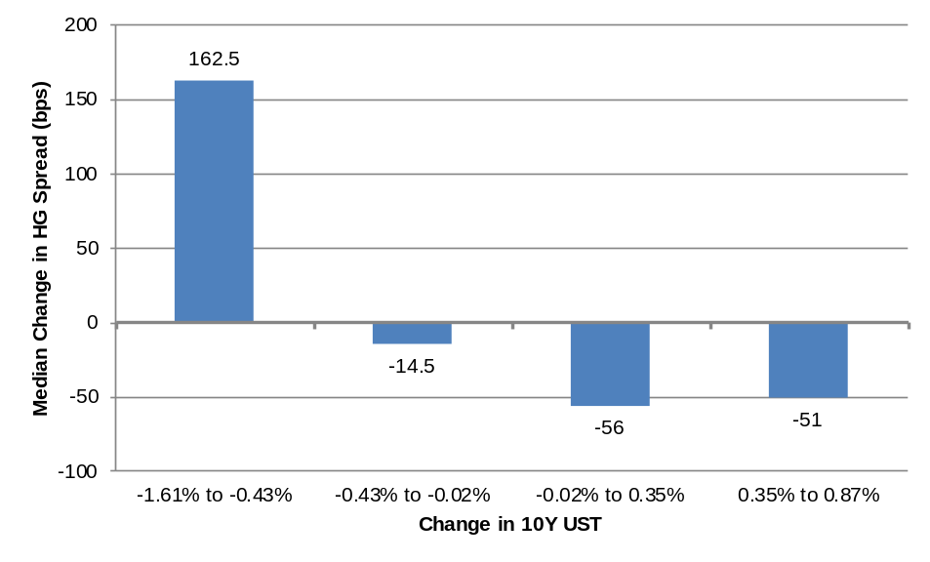
Behavior of Credit Spreads
As expected, credit spreads are negatively correlated with GDP
Moreover, spread movements seem to significantly offset movements in treasuries

Slide 19
1. | US Macroeconomic Outlook
2. | Efficient-Frontier Funding Strategies
3. | A Sixty-Year History of Interest Rates
4. | History of Economic Growth: GDP and the Stock Market
Notes:
19

Slide 20
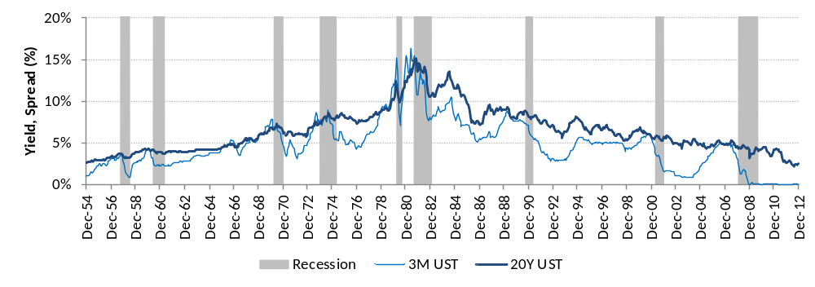
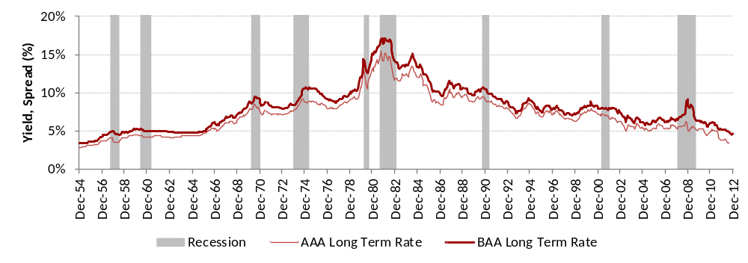
Behavior of US Interest Rates, Jun 1954 - Present
Until the early 1980s, US interest rates trended up, primarily driven by rising inflation. Since then, the trend has reversed itself, primarily by falling inflation, but also by declining real interest rates, particularly after the onset of the 2007 great contraction.
Because issuing long-term is beneficial in a rising rate environment, the liability management decision is effectively a forecasting exercise.
Government Rates
Corporate Rates (Moody’s)
Source: Federal Reserve.
Page 20
Notes:
20

Slide 21
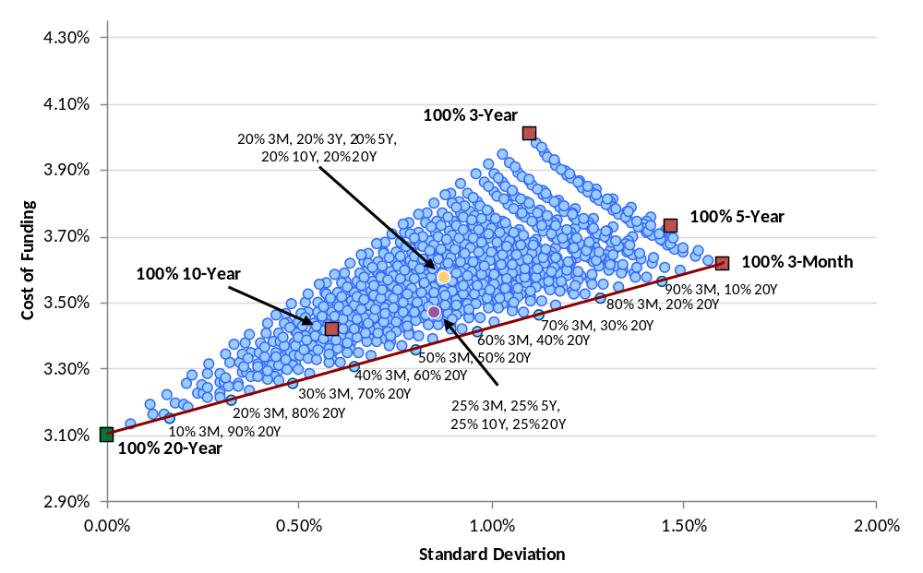
The Efficient Frontier: A Corporate Treasurer’s Perspective (Cont’d)
During periods of rising interest rates, as observed in the US from 1953 to 1973, issuing long-term debt proves to be an outright winner over shorter-term options. This strategy provides issuers with the lowest interest rate volatility and the lowest cost of funding. Stated differently, the efficient frontier consists of one point.
Liability Portfolio Efficient Frontier in a Rising Interest Rate Environment, Apr 1953 – Apr 1973,
(Using Treasury Rates)
Barbells (3M and 20Y)
Efficient Frontier
Source: Federal Reserve, calculations by Ramirez & Co.
Page 21
Notes:
21

Slide 22
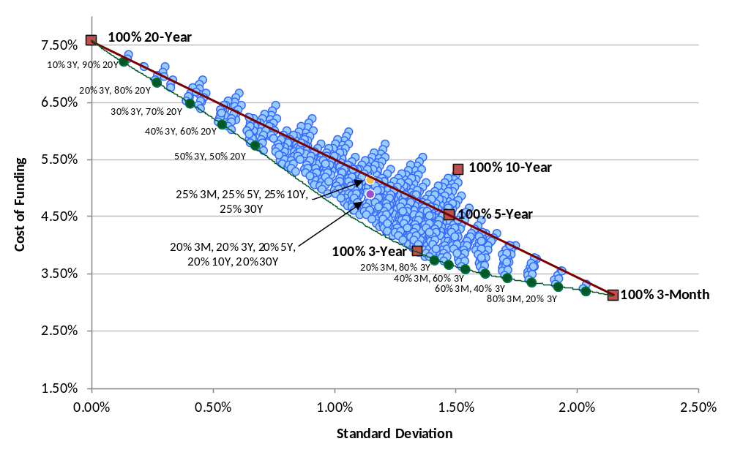
The Efficient Frontier: A Corporate Treasurer’s Perspective (Cont’d)
During periods of falling interest rates as observed in the US from 1991 to 2013, the issuer faces a tradeoff between lowest funding cost volatility (achieved by issuing long-term debt) and lowest funding cost (achieved by issuing short-term debt).
Liability Portfolio Efficient Frontier in a Falling Interest Rate Environment, Jan 1993 – Jul 2013,
(Using Treasury Rates)
Barbells (3M and 20Y)
Efficient Frontier
Source: Federal Reserve, calculations by Ramirez & Co.
Page 22
Notes:
22

Slide 23
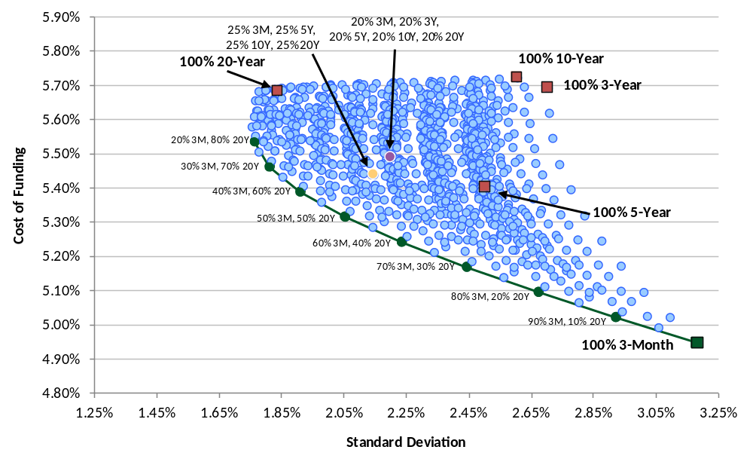
The Efficient Frontier: A Corporate Treasurer’s Perspective (Cont’d)
During periods of both rising and falling interest rates as observed in the US from 1953 to 2013, the issuer faces a tradeoff similar to a falling interest rate environment. As such, the efficient frontier consists of a barbell strategy of 3M and 20Y instruments (except for the 100% 20-Year point).
Liability Portfolio Efficient Frontier in a Mixed Interest Rate Environment, Apr 1953 – Jul 2013,
(Using Treasury Rates)
Efficient Frontier
Source: Federal Reserve, calculations by Ramirez & Co.
Page 23
Notes:
23

Slide 24
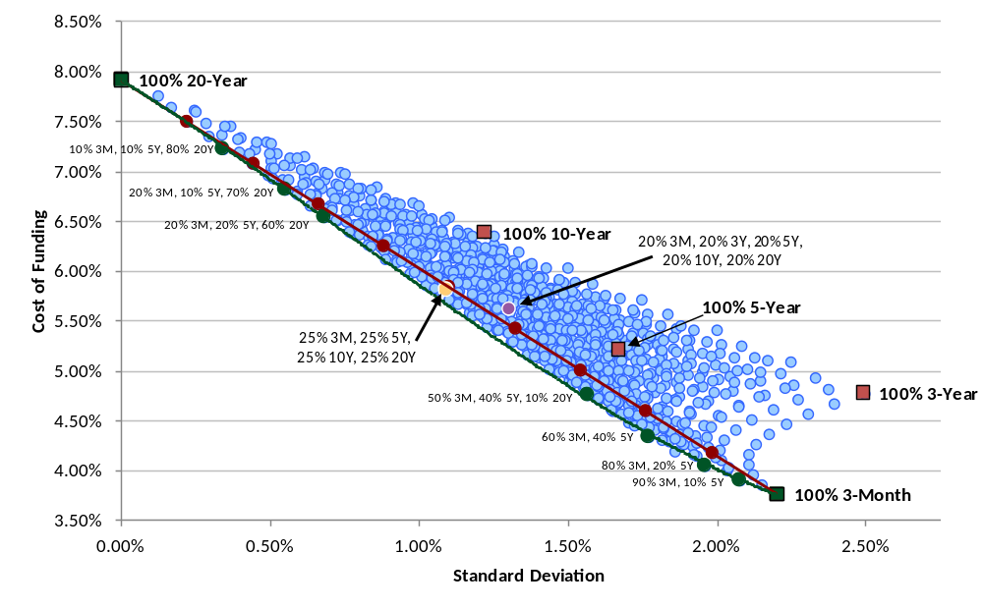
The Efficient Frontier: A Corporate Treasurer’s Perspective (Cont’d)
Using shock-adjusted SWAP rates (500 bps in September 2008 – September 2009), the barbell strategy moves away from the efficient frontier. The evenly distributed 3M, 5Y, and 20Y portfolio is exactly on the efficient frontier. This observation suggests that the 3M, 5Y, and 20Y instruments may be the principle instruments in determining the efficient frontier.
Liability Portfolio Efficient Frontier, May 1994 – Jul 2013,
(Using Shock-Adjusted SWAP Rates)
Barbells (3M and 20Y)
Efficient Frontier
Source: Bloomberg, calculations by Ramirez & Co.
Page 24
Notes:
24

Slide 25
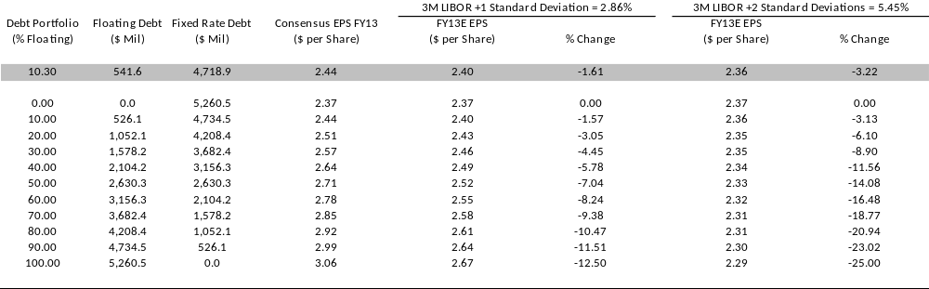
EPS Sensitivity Under Varying Funding Scenarios
2013 EPS Estimate vs. % Floating Rate Debt Mix Under Varying 3-Month LIBOR Assumptions
  Floating rate debt generally provides firms with lower cost of funding during upward-sloping yield curve environments, however, issuing floating-rate debt leaves firms with added cash flow volatility
  With 3-Month LIBOR near its all-time lows, assuming a one standard deviation move up in LIBOR still makes floating-rate debt appear relatively more attractive
Note: 3-Month LIBOR standard deviation calculated based on 25-years of historical data.
Variable borrowing spread of 20 bps used; weighted-average borrowing cost on WEC variable-rate LT debt as of 12/31/12.
2013 Consensus EPS and weighted average long-term cost of funding figures as per Bloomberg.
Source: Company Filings, Bloomberg.
Notes:
25

Slide 26
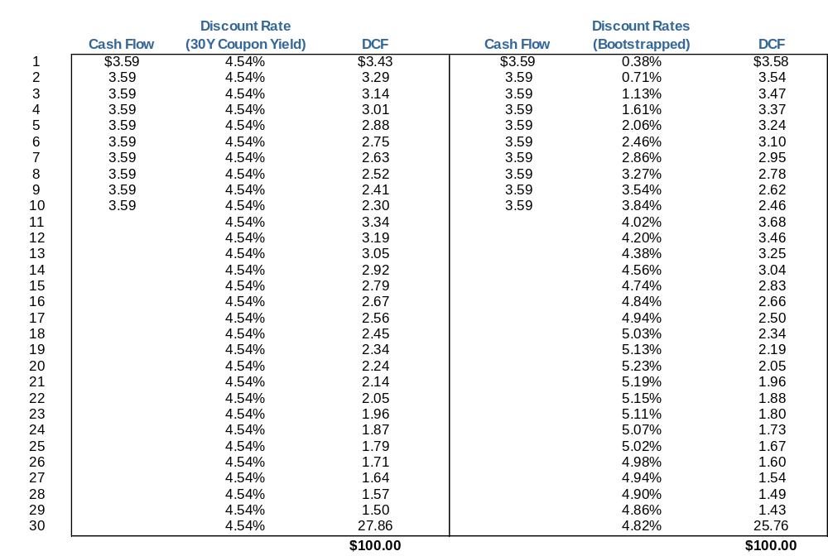
Issuing 30Y vs. 10Y Plus 20Y
Currently, 10Y, 20Y and 30Y Single A rated Utility yields are 3.59%, 4.64% and 4.54%, respectively.
If the 20Y rate increases to 5.67% and beyond in 10 years, a current 30Y funding would be more cost efficient.
This represents an 103 bps increase from today’s 20Y level.
30Y Financing vs. 10Y and Subsequent 20Y: Break-Even Rates
Note: Based on indicative data for the Utilities index, the Company’s yields may be different.
Source: Bloomberg, Ramirez & Co. estimates.
Notes:
26

Slide 27
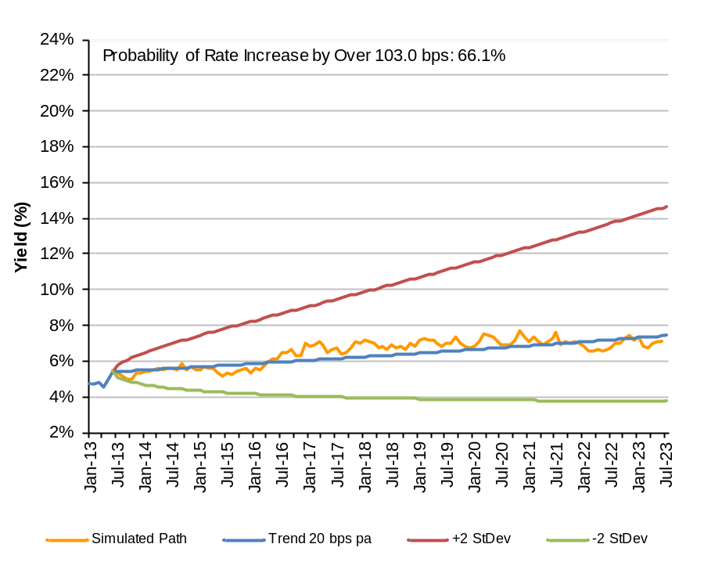
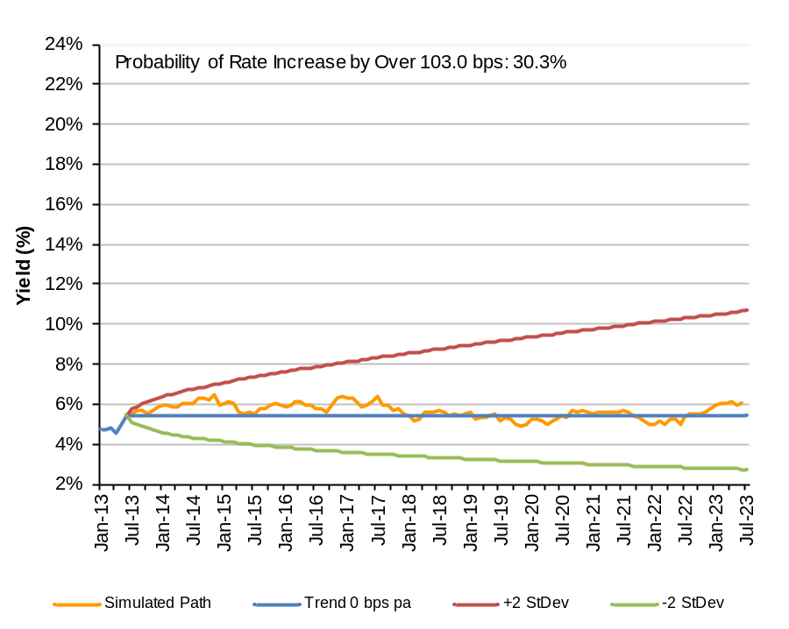
Interest Rates Scenarios
Reverting to the Mean, 10Y Horizon
Neutral, 10Y Horizon
From 1984 to the present, corporate yields have trended down at an approximate rate of 20 bps per year. Mean-reversion of rates would suggest that the likelihood of an increase of over 103 bps in long-term rates is approximately 66%
With zero trend, the likelihood of an over increase over 103 bps is around 30%
Note: Based on volatility of 3.09% per month (10.71% annualized), per ML BBB/A 15+ Industrial Index.
Source: Ramirez & Co. estimates.
Notes:
27
27

Slide 28
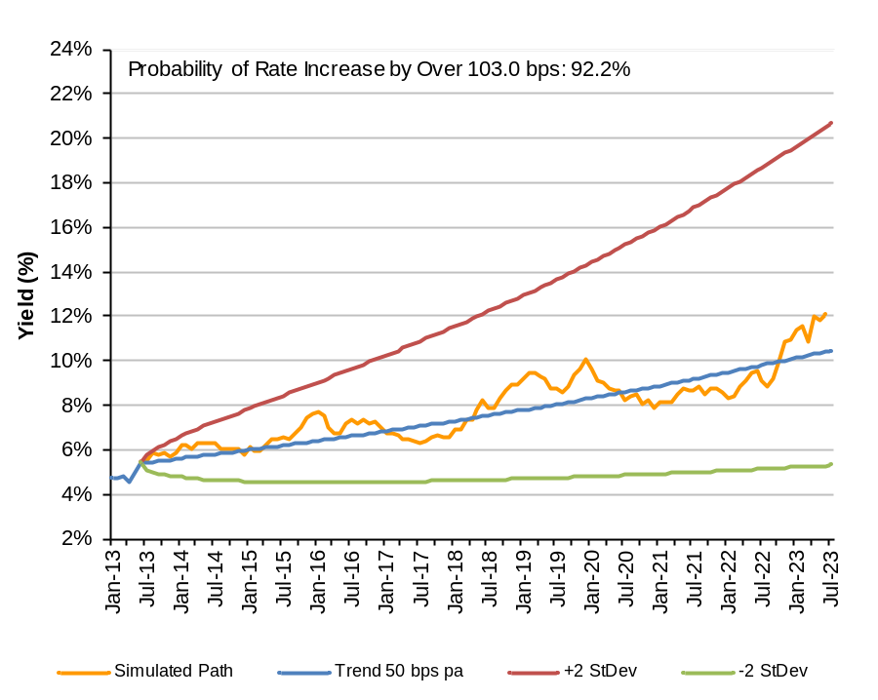
Interest Rates Scenarios (Cont’d)
High Inflation, 10Y Horizon
While inflation does not seem to be an immediate threat, a number of factors suggest that it may be a future threat
  Inflated Fed balance sheet
  High commodity prices (e.g. gold and oil)
Note: Based on volatility of 3.09% per month (10.71% annualized), per ML BBB/A 15+ Industrial Index.
Source: Ramirez & Co. estimates.
Notes:
28
28

Slide 29
1. | US Macroeconomic Outlook
2. | Efficient-Frontier Funding Strategies
3. | A Sixty-Year History of Interest Rates
4. | History of Economic Growth: GDP and the Stock Market
Notes:
29

Slide 30
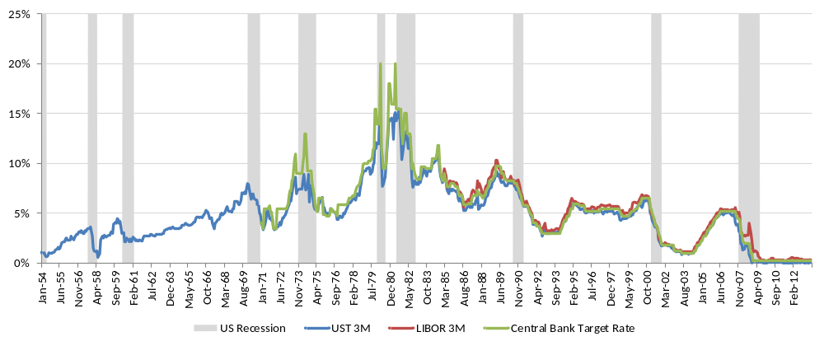
Short-Term Interest Rates
Short-term rates decline during recessions

Slide 31
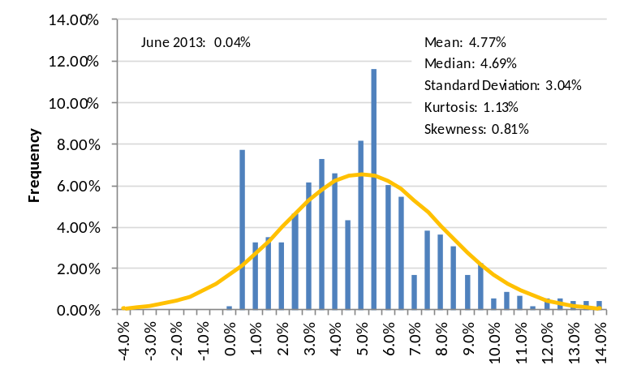
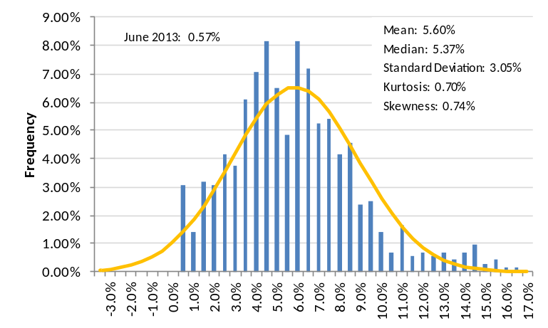
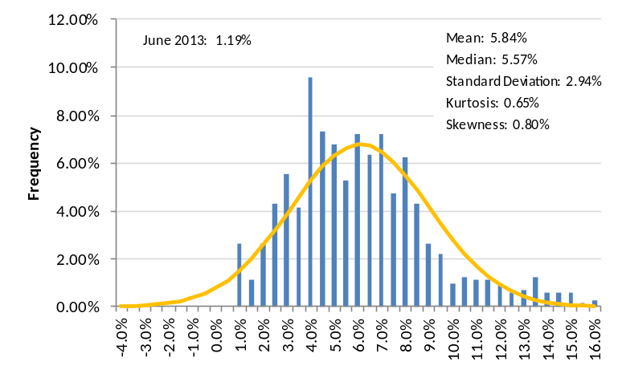
US Treasury Rates
3M T-Bill Yield, Jan 1954 – Jun 2013
3Y T-Note Yield, Apr 1953 – Jun 2013
Note: The data start on Jan 1954 for the 3M UST
5Y T-Note Yield, Apr 1953 – Jun 2013
Source: Ramirez & Co. calculations, Federal Reserve, Bloomberg.

Slide 32
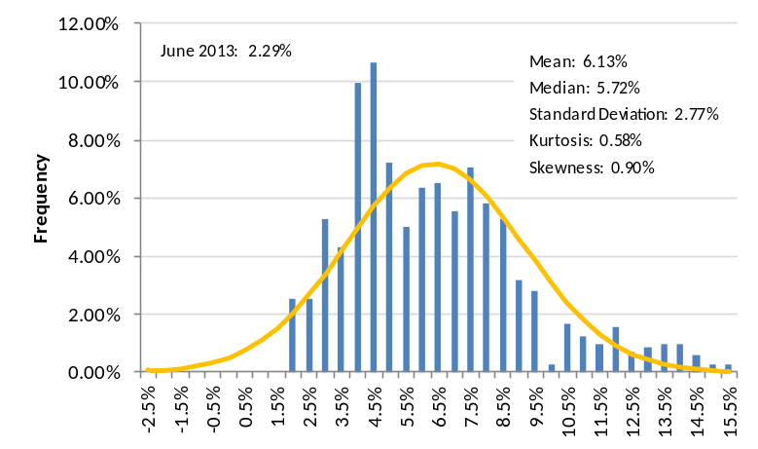
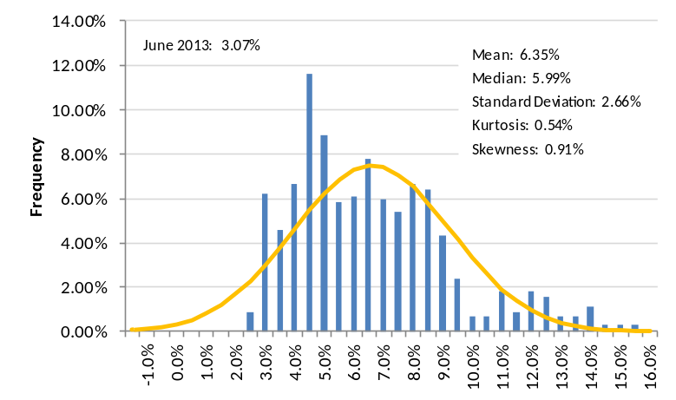
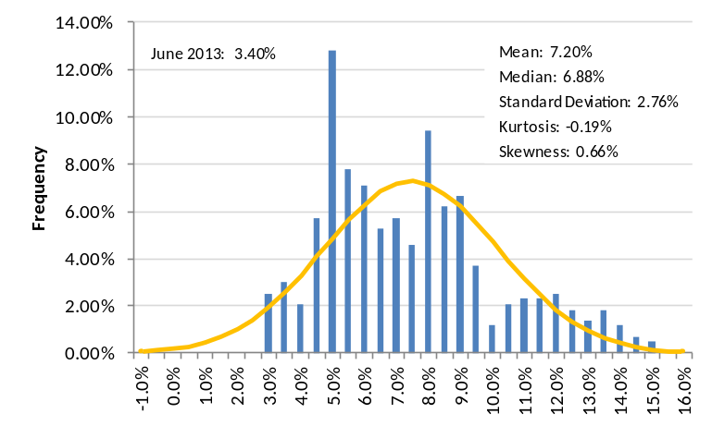
US Treasury Rates (Cont.)
10Y T-Note Yield, Apr 1953 – Jun 2013
20Y T-Bond Yield, Apr 1953 – Jun 2013
30Y T-Bond Yield, Feb 1977 – Jun 2013
Note: Data for the 20Y UST are not available for Jan 87 – Sep 93. We compute the missing data by linearly interpolating the 10Y and the 30Y. No data available for June 2013 as of July 1, 2013.
Note: Data for the 30Y UST are not available for Mar 02 – Jan 06. For this period Bloomberg substitutes CUSIP 912810FP, issued 2/15/01 with maturity date 2/15/31. Moreover, data for the 30Y are not available for Apr 53 – Mar 77.
Source: Ramirez & Co. calculations, Federal Reserve, Bloomberg.

Slide 33
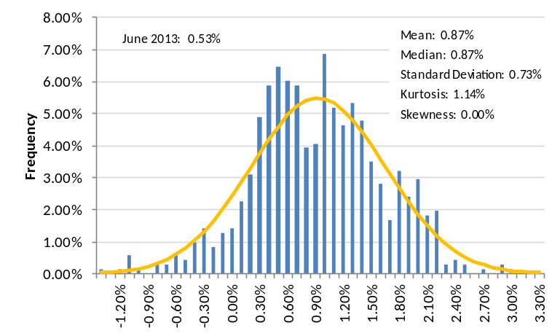
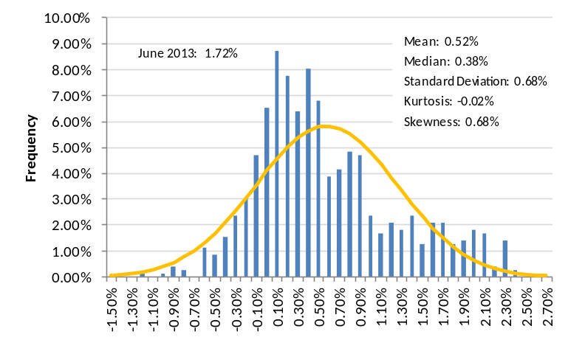
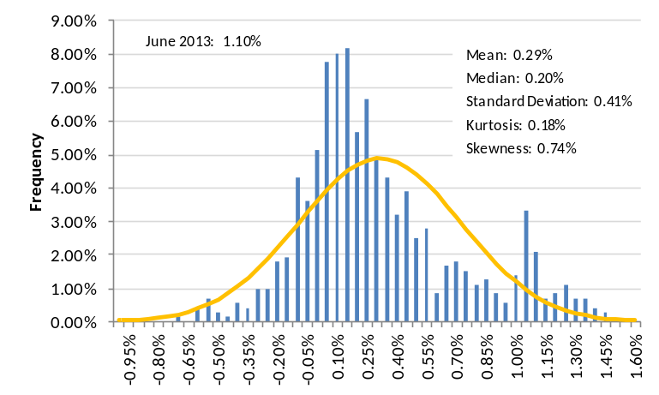
US Treasury Spreads
3Y – 3M, Jan 1954 – Jun 2013
10Y – 3Y, Apr 1953 – Jun 2013
10Y – 5Y, Apr 1953 – Jun 2013
Source: Ramirez & Co. calculations, Federal Reserve, Bloomberg.

Slide 34
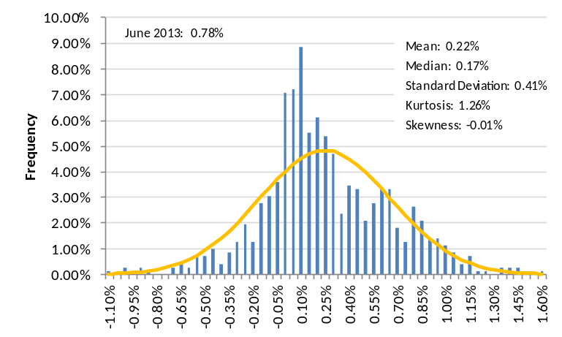
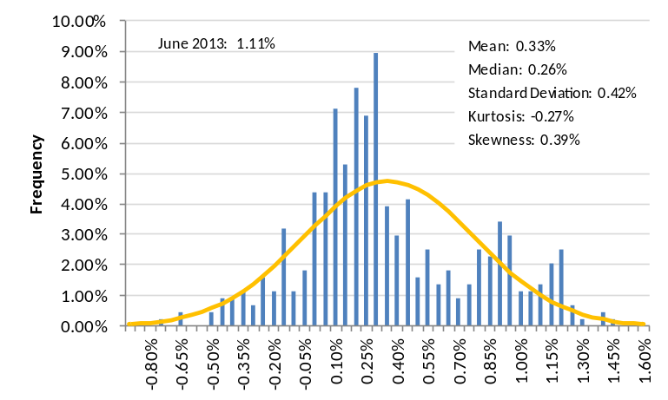
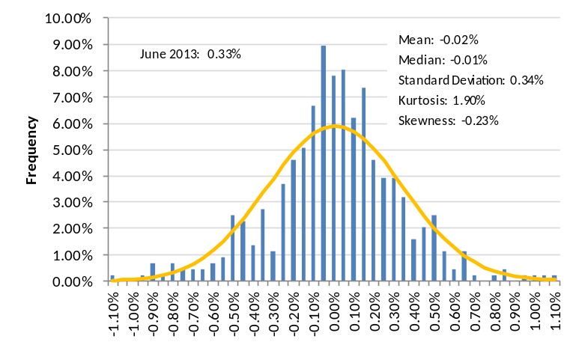
US Treasury Spreads (Cont.)
20Y – 10Y, Apr 1953 – Jun 2013
30Y – 10Y, Feb 1977 – Jun 2013
30Y – 20Y, Feb 1977 – Jun 2013
Source: Ramirez & Co. calculations, Federal Reserve, Bloomberg.

Slide 35
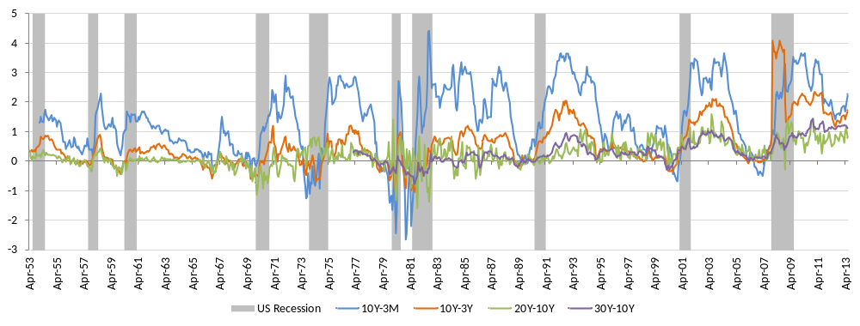
US Treasury Spreads
Conventional wisdom suggests that the yield curve flattens before a recession, and steepens during one

Slide 36
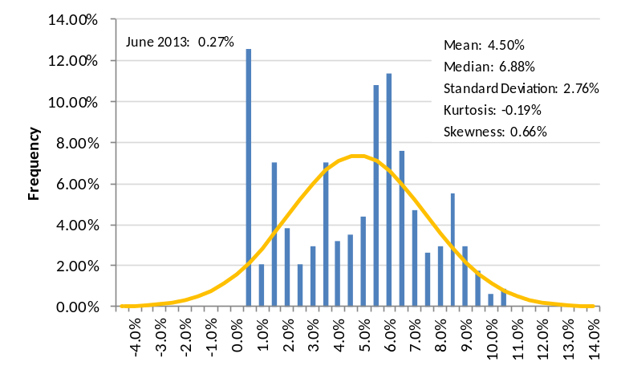
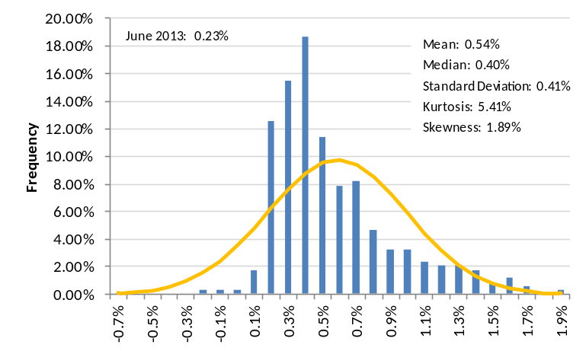
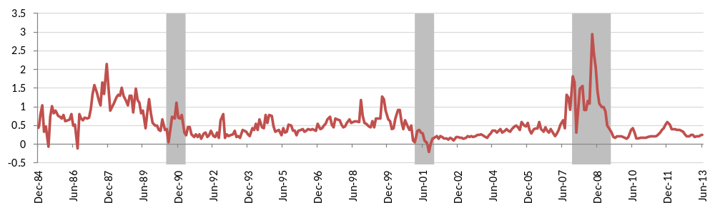
LIBOR Rates and Spreads
LIBOR 3M, Dec 1984 – Jun 2013
LIBOR – UST 3M Spread, Dec 1984 – Jun 2013
LIBOR – UST 3M Spread
Note: US Recession periods in gray
Source: Ramirez & Co. calculations, Federal Reserve, Bloomberg.

Slide 37
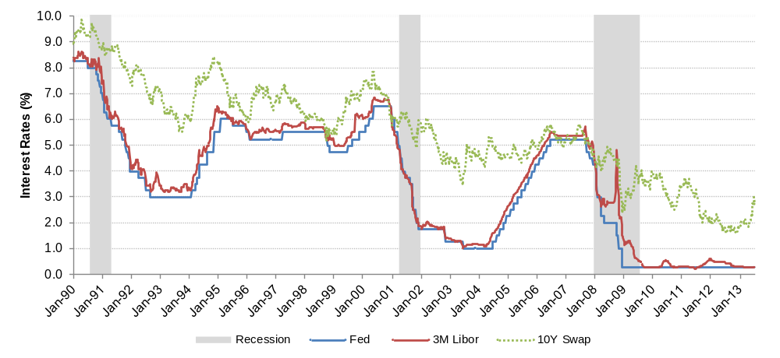
Velocity of Interest Rates
3M Libor and Fed Funds Target Rate vs. 10Y Swap
peak - trough 331 bps in 1 yr and 10 mos, 180.5 bps/yr
peak - trough 184.3 bps in 1 yr and 8 mos, 110.4 bps/yr
peak - trough 437 bps in 2 yrs and 3 mos, 194.2 bps/yr
Short-term rates may increase rapidly as the economy recovers
Following the Fed’s tightening cycle in 2004, short-term rates increased approximately 440 bps in 27 months
Note: Peak to trough LIBOR
Source: Bloomberg.
Notes:
37

Slide 38
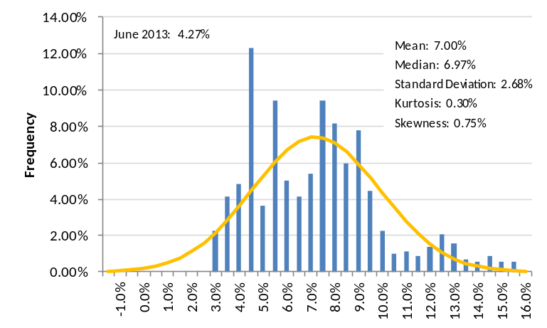
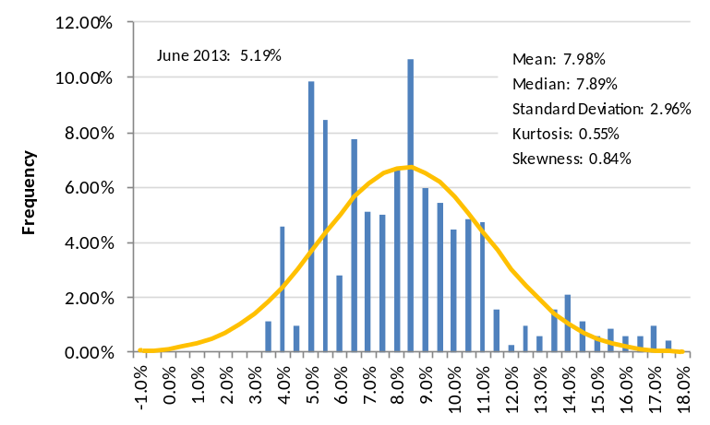
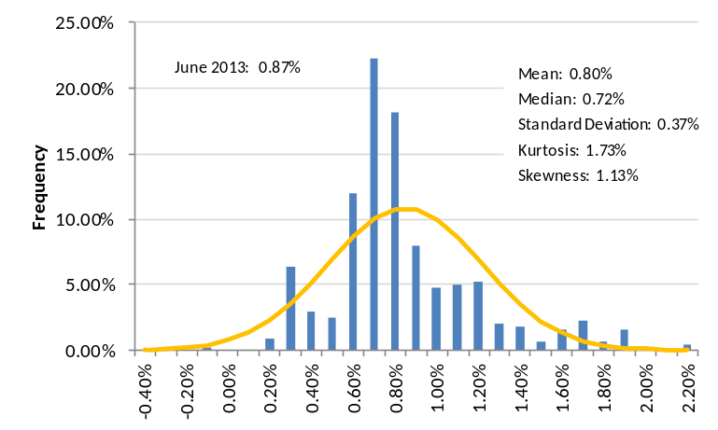
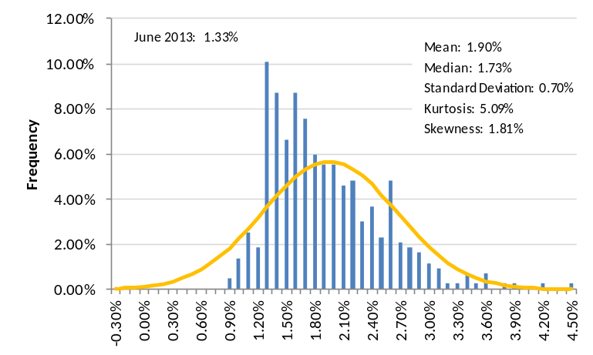
Moody’s Corporate Bond Yields
Moody’s Aaa (30Y), Apr 1953 – Jun 2013
Moody’s Baa (30Y), Apr 1953 – Jun 2013
Moody’s Aaa Spread vs UST 30Y, Feb 1977 – Jun 2013
Moody’s Baa Spread vs UST 30Y, Feb 1977 – Jun 2013
Note: Credit ratings are for bonds with maturities as close to 30 yrs as possible and no sooner than 20 yrs.

Slide 39


Inflation Indicators
US HCPI Inflation, Apr 1953 – May 2013
US CCPI Inflation, Feb 1957 – May 2013
Note: CCPI Inflation is defined as HCPI excluding food and energy.

Slide 40



Treasury Inflation Protected Securities (TIPS)
TIPS 5Y, Jul 1997 – Jun 2013
TIPS 10Y, Jan 1997 – Jun 2013
TIPS 30Y (Calculated), Jan 1999 – Jun 2013
Note: TIPS 30Y calculated as the difference between UST 30Y and the 30Y breakeven index as reported by Bloomberg.

Slide 41




Computed UST Real Rates
HCPI Adjusted 3M Real Rate, Jan 1954 – Jun 2013
CCPI Adjusted 3M Real Rate, Feb 1957 – Jun 2013
HCPI Adjusted 3Y Real Rate, Apr 1953 – Jun 2013
CCPI Adjusted 3Y Real Rate, Feb 1957 – Jun 2013

Slide 42




Computed UST Real Rates (cont.)
HCPI Adjusted 5Y Real Rate, Apr 1953 – Jun 2013
CCPI Adjusted 5Y Real Rate, Feb 1957 – Jun 2013
HCPI Adjusted 10Y Real Rate, Apr 1953 – Jun 2013
CCPI Adjusted 10Y Real Rate, Feb 1957 – Jun 2013

Slide 43




Computed UST Real Rates (cont.)
HCPI Adjusted 20Y Real Rate, Apr 1953 – Jun 2013
CCPI Adjusted 20Y Real Rate, Feb 1957 – Jun 2013
HCPI Adjusted 30Y Real Rate, Feb 1977 – Jun 2013
CCPI Adjusted 30Y Real Rate, Feb 1977 – Jun 2013

Slide 44



HCPI vs CCPI Adjusted Real Rates
HCPI Adjusted 10Y Real Rate, Jan 1997 – Jun 2013
CCPI Adjusted 10Y Real Rate, Jan 1997 – Jun 2013
TIPS 10Y, Jan 1997 – Jun 2013
For the period during which the TIPS 10Y is available the mean and standard deviation of the CCPI adjusted rate are 2.18% and 1.44% respectively.
This is a divergence of 2 percentage points from the TIPS mean and 9 percentage points from the TIPS standard deviation. In contrast to the HCPI adjusted rate, this represents a better estimation of the real rate.

Slide 45

CCPI Adjusted UST Real Rates

Slide 46
1. | US Macroeconomic Outlook
2. | Efficient-Frontier Funding Strategies
3. | A Sixty-Year History of Interest Rates
4. | History of Economic Growth: GDP and the Stock Market
Notes:
46

Slide 47

GDP Growth, Jun 1953 – Mar 2013
Note: All GDP data are quarterly.

Slide 48



S&P 500 Earnings
S&P 500 Nominal Earnings YoY, Dec 1954 – Dec 2012
S&P 500 Real Earnings YoY (HCPI Adjusted), Dec 1954 – Dec 2012
S&P 500 Real Earnings YoY (CCPI Adjusted) , Dec 1958 – Dec 2012

Slide 49



S&P 500 P/E Multiples
Trailing P/E, Jan 1954 – Jun 2013
Current P/E, Jan 2006 – Jun 2013
Next Year P/E, Jan 2006 – Jun 2013

Slide 50



S&P 400 Earnings
S&P 400 Nominal Earnings YoY, May 1993 – Jun 2012
S&P 400 Real Earnings YoY (HCPI Adjusted), Dec 1993 – Dec 2012
S&P 400 Real Earnings YoY (CCPI Adjusted) , Dec 1993 – Dec 2012

Slide 51



S&P 400 P/E Multiples
Trailing P/E, Dec 1990 – Jun 2013
Current P/E, Jan 1995 – Jun 2013
Next Year P/E, 1995 – Jun 2013

Slide 52




Components of Beta: Insurance Industry
1Y Daily Correlation, Jan 2003 – Jul 2013
1Y Daily Volatility (Annualized), Jan 2003 – Jul 2013
5Y Weekly Correlation, Oct 2006 – Jul 2013
5Y Weekly Volatility (Annualized), Oct 2006 – Jul 2013
Note: PFG went public on 10/31/01, therefore the calculated 5-yr corr. and st. dev. data begin 5 years hence in Oct 2006.
Corr. and st. dev. calculated for the % change in list price at the end of the day for the frequency denoted (Daily, Weekly)

Slide 53



PFG Deconstructed Rolling Beta
1Y Daily, Oct 2002 – Present
5Y Weekly, Oct 2006 – Present
Note: Corr. and st. dev. calculated for the % change in list price at the end of the day for the frequency denoted (Daily, Weekly)
Relative Volatility defined as the ratio of the st. dev. of the change in stock price to the st. dev. of the change in the S&P500 Index.
Source: Bloomberg, Ramirez Calculations.
Notes:
53

Slide 54


Components of Beta: Insurance Industry
Pre-Crisis 1Y Daily Beta Components, Jan 2007 – Jan 2008
Current 1Y Daily Beta Components, Jul 2012 – Jul 2013
Note: Corr. and st. dev. calculated for the annualized % change in list price at the end of the day for the frequency denoted (Daily, Weekly)

Slide 55


Components of Beta: Insurance Industry
Pre-Crisis 5Y Weekly Beta Components, Jan 2003 – Jan 2008
Current 5Y Weekly Beta Components, Jul 2008 – Jul 2013
Note: Corr. and st. dev. calculated for the annualized % change in list price at the end of the day for the frequency denoted (Daily, Weekly)

Slide 56


Cost of Equity: Current Utility Betas
As would be expected, the median beta for a sampling of diversified utility companies is higher than the median beta for regulated utilities and lower than the median beta for selected E&P and merchant power companies.
2-Yr. Daily Betas, Jul 2011 – Jul 2013
5-Yr. Weekly Betas, Jul 2008 – Jul 2013
Source: Bloomberg.
Notes:
56

Slide 57


Cost of Equity: Leverage vs. Beta
2-Yr. Daily Betas, Jul 2011 – Jul 2013
5-Yr. Weekly Betas, Jul 2008 – Jul 2013
  Using MVL as a measure of leverage shows that there is correlation between levered beta and leverage in the utility space
  Looking at 2-Yr. betas shows a lack of statistical relationship between market risk and leverage
  If MVL increases by 10%, 5-Yr. Beta increases by approximately 7 bps
Source: Bloomberg.

Slide 58


Cost of Equity: Unlevered Betas
2-Yr. Daily Unlevered Betas, Jul 2011 – Jul 2013
5-Yr. Weekly Unlevered Betas, Jul 2008 – Jul 2013
  Unlevering 5-Yr. Utility sector Betas produces coefficients that are close to zero, which suggests that calculating unlevered Beta fairly estimates the expected effect of leverage on Beta
    B_{L} = B_{U} x [1+ (1-T) x (D/E)]
Source: Bloomberg.

